Slide 1
DATAVIZ 300 Week 3: Data

Slide 2
Reminders… Class extended through 6/14

Slide 3
VizWiz extended to 5/2 at midnight

Slide 4
New License Key TDG8-B376-3950-33CA-10B1

Slide 5
beta.tableau.com

Slide 6
Today’s Lesson: How Data works in Large Orgs Getting Data to Tableau Once Data is in Tableau Hands On – Survey Data Homework

Slide 7
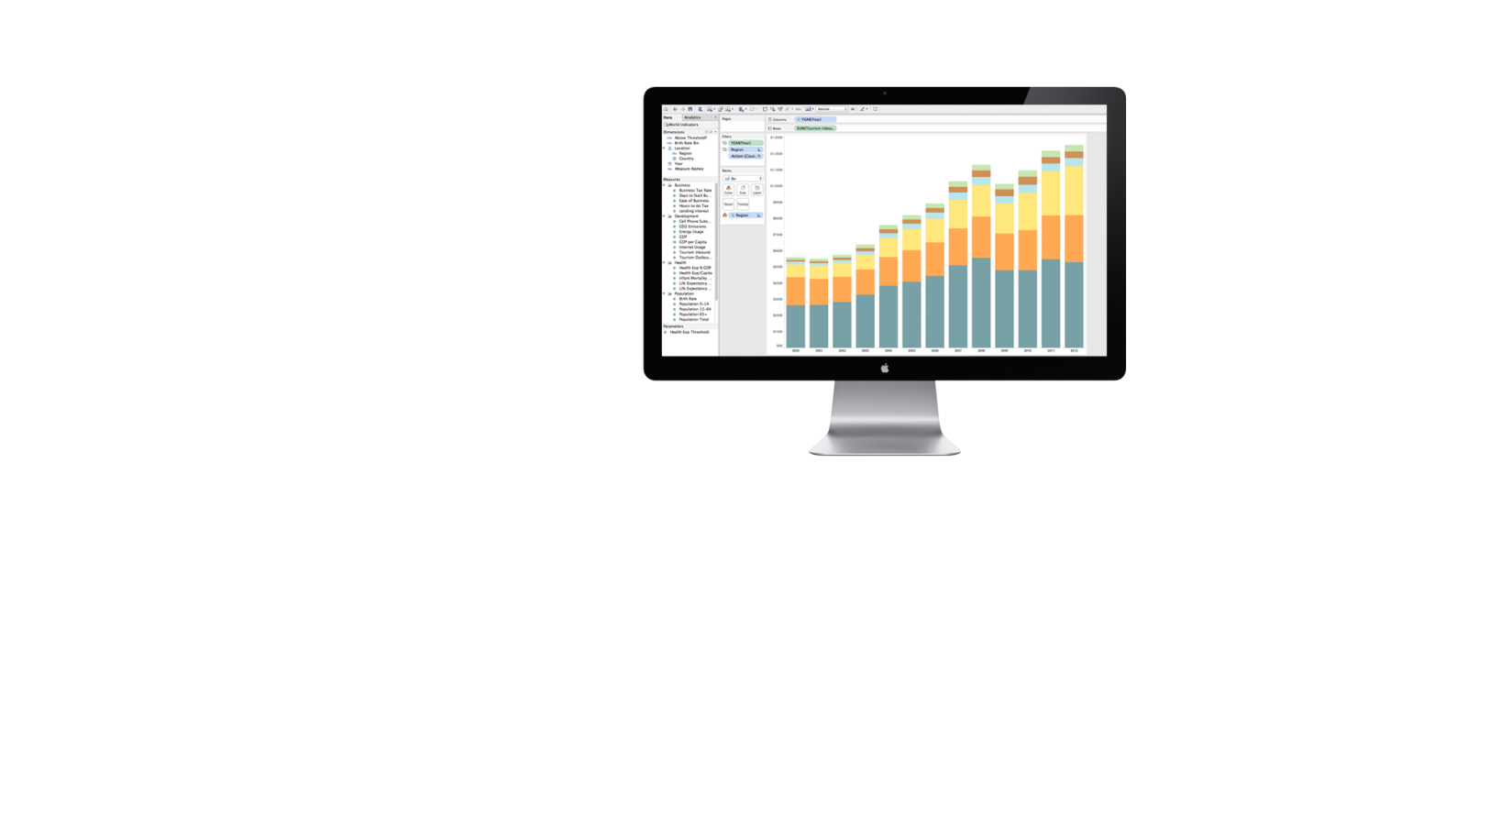
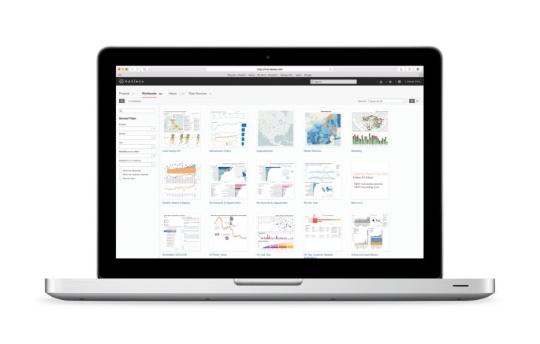
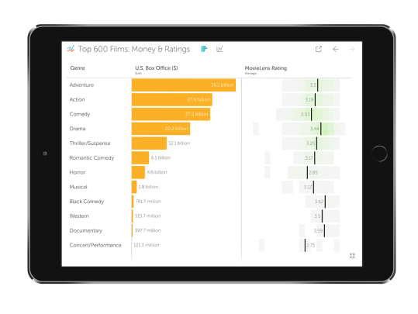
Product Portfolio
Tableau Desktop
Tableau Public
Tableau Server
Tableau Online
Vizable

Slide 8





Where are things today?
Susie
Manager
Chris
Analyst
Norm
Architect
Peter
Analyst
Kelly
Executive
ASK
ANSWER
Notes:
To get started, lets look at where most organizations are today in terms of two groups of users. There are those that want to ask a question of their data, and those that have the ability to answer those questions.
For most organizations there is a limited group of users that are able to answer the questions. Here we have Norm, who is an IT architect but could also have a title like BI developer and he probably uses something like a OBIEE, Cognos or Business Objects to push out reports to answer the questions of the business. So Suisse the manager, Chris and Peter our analyst, and Kelly the executive all send their questions to Norm, who sends back the answer in the form of a report. BARC, which is similar to IT research company's like Gartner, actually did a study on this and found that on average, only 8% of people in organizations today can both ask and answer their own questions. Now for a couple reasons this set up made a lot of sense. First off, most of the business users don’t have the coding or SQL skills to use these tools, Norm is the only one who can use them.
And this actually works out really well for Norm. Because Norm pushed out the answers to the business, it means he can also put tight controls around security and governance. Which from an Enterprise perspective is mission critical and gives Norm the ability to manage who see’s what.

Slide 9
How does this play out in organizations today?
Notes:
So lets step into a day in the life and see how this plays out in most organizations today.

Slide 10




















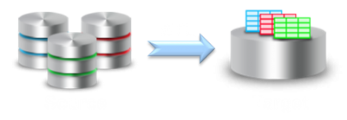

















Analyze
Analyze
!?
Plan
Plan
Design
Design
Peter - Analyst
Peter - Analyst
Susie - Manager
Develop
Develop
Test
Test
Produce
Produce
Maintain
Maintain
Dashboards
Reports
!?
Build Metadata
Semantic Layer
Norm - Architect
Legacy Platform
Manage
Data Infrastructure
Monitor
ETL
EDW
Data Marts
Cubes
Extract – Transform - Load
Data
Sources
Notes:
At the very foundation of your enterprise lies your raw data sources. You then have ETL processes in place that serve data up to your data marts, cubes, and data warehouses.
Then you have the Enterprise BI stack that includes a Semantic model and dashboards and reports that sit on top.
Then we have Norm, our BI Architect. He has access the underlying data, monitors the ETL processes, manages the data infrastructure, and builds metadata to support the needs of the business. This is where he authors all the reports to answer questions the business has.
Then we have Peter, a business analyst that has question so he connects to a report Norm built to get his answer.
That report is really just serving as a proxy to the underlying data and security is either managed at the data source level or more likely, within the semantic layer.
But here lies the challenge, inevitably Peter is going to ask a question that isn’t answered by the reports he has access to. So to get at the data he needs, he files a support ticket. That ticket makes its way over to Norm, but Norm is a busy guy and Peter is not the only one with change requests so it gets put on top of the pile.
Let’s look at this que for a moment, because as this fills up Peter is going to have to wait longer and longer to get his answer. Now what Peter doesn’t realize, is that what he thinks is a simple change request, is not so simple. Let’s say Peter is just asking for a couple fields to be added to the report. But those fields don’t exist in the report because they are not in the semantic layer, or the data mart, or the ETL job, because they come from a separate data source that was not previously included. Norm is forced to go through a time consuming waterfall process that requires changes in every layer of the BI stack. And remember this is just one request.
Eventually Norm does make his way through the queue, pushes out the enhancement, and Peter gets the answer he needs.
But then Peter has another question because the enhancement Norm made either didn’t quite answer the question he had or Peter saw something new and he wants to dive into it further. So the same process happens. Files a change request, which gets dumped into the que, Norm goes through h the change process, Peter waits, Norm pushes out the enhancement, and Peter gets his answer, or at least a partial answer. We call this process the report factory, is this something you see in your organization?
And this process repeats itself over and over eventually leaving both Peter and Norm very frustrated.
So what’s really going on here that causes a line in the sand to be drawn between IT and the business? When Peter sends Norm a change request, he is really asking him to answer a question he has about the business. But Norm doesn’t have the full context about the question Peter is asking, because lets face he is not a mind reader, so he probably doesn’t fully answer what Peter was asking. But even if Norm did fully answer Peter’s question, Peter may see something new and have 3 or 4 more questions. The crux of the matter is that the legacy platforms were really built to help answer the known-unknowns. These are the measures and metrics your organization already knows that they need to monitor to assess the health and performance of the company. These are things like the quarterly billing, bookings, and backlog reports. However, what Peter is really interested in is the unknown-unknowns. These are the questions that haven't yet been asked or are metrics that haven’t been looked at. The one off, ad-hoc, unanticipated questions that are not answered in existing reports. As we have seen, the challenge is the legacy platforms aren’t agile enough to get Peter the answers he needs in the time he needs them. Is this reflective of where the relationship is between IT and business for you?
So what inevitably happens? The system cracks– either literally or figuratively. Peter needs answers so he goes rouge.
He downloads the data he has access to into csv’s and then, out of the either emerges shadow IT. Shadow IT figures out a way to get access to the data, pulls that data into a SQL server they probably have running on a stolen desktop under someone’s desk, which allows Peter to pull out the data he needs.
But when Peter does this, any trace of security disappears and Peter spends countless hours having to curate all this data into his spreadmart. And this becomes a primary source of information that the Peter’s team used to make decisions.
What’s scary, is that Peter is not alone. There is a whole Army of Peters out their that are running the business on these self curated Spreadmarts
Most would agree that running the business off spread marts is not ideal for a couple reasons. Once the data is pulled into Excel, any investment into security is lost. We start to see multiple versions of the truth emerge because the Peter’s of the world pull in their data a bit differently. And maintaining these spread marts comes at a huge cost to Peter’s time. Out of curiosity, how well does this describe your current environment?

Slide 11
How is Tableau Different?
Susie
Manager
Chris
Analyst
ASK
ANSWER
Norm
Architect
Kelly
Executive
Peter
Analyst
Notes:
So the question now is, how does Tableau fit in and how are we different.
At Tableau, we believe that everyone should be able to see and understand their data which means that anyone can both ask and answer their own questions. From a business perspective this makes a lot of sense the business really the ones best equipped to answer their own questions rather than trying to have Norm read their minds. Often, this why Peter goes rogue because he just wants to get answer. But from an IT perspective, it raises the question of how do you enable the business in a secure and governed way. We cant just open the kimono and let the business roll around naked in their data. So lets go through a day in the life with Tableau and see how we can enable the business without losing ?

Slide 12


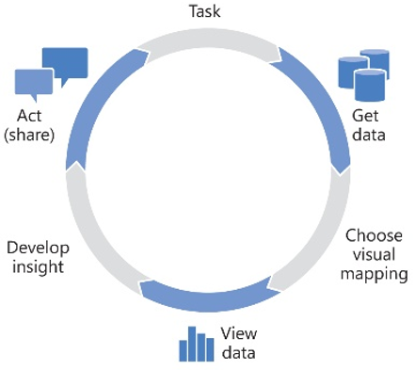


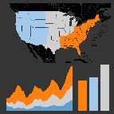

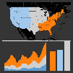








Analyze
Plan
Design
Chris - Analyst
Develop
Peter - Analyst
Susie - Manager
Kelly - Executive
Test
Produce
Maintain
Tableau Server
Repository
Presentation
Dashboards
Reports
Database
Performance
Data Server
Project Folders
published
data sources
Sandbox
QA
Prod
live
Semantic Layer
MDM and ETL
Norm - Architect
Data Quality
Data Cleanliness
Legacy Platform
extract
live
EDW
Data Marts
Cubes
Extract – Transform - Load
Data
Sources
Notes:
Let’s start where most organizations bring in Tableau. Typically, we see someone from the business who tiered of spending all their time in Excel, want to make better visualizations, or has some other need so they bring in Tableau. At first they just connect to the spread marts and build out interactive dashboards that they then share with their team. Nothing has changed process wise, Peter just can make better sense of all his data in Excel.
Eventually, they realize the need a better way to share content and so they get started on Tableau Server where Peter can publish his content and have Susie and the rest of the team consume it there. Now it’s important to call out that the legacy platform doesn’t go away, we just use it for what its good at, answering those known-unknowns . And we are now using Tableau to address the unknown-unknowns.
Once server gets set up, Norm is typically brought in for the first time and a lot of times feels a bit overwhelmed. He is tasked to manage something that has grown organically and may have become a bit unwieldly. But what Norm will soon find out though, is that Tableau Server has just as much, if not more, that will benefit him as it does the business. With Tableau Server, Norm has a central place to manage the environment which allows him to do things like monitor usage, update configuration, and build out security and governance. Through the presentation layer, he can control if users can interact, download, or edit a dashboard. He can also manage what content Peter and his team can access and where they can publish. Tableau Server also keeps track of everything that’s going on in the environment so Norm can see what users are actually using the system, which reports get the most traffic, and what data sources are being used. Server even has built in visualizations of this information so all these questions can be answered out of the box. This allows Norm to see that Peter’s built a great dashboard and it’s getting a lot of visibility but it is built off an Excel file. So Norm reaches out to Peter and tells him that he can build out a data source that will be updated automatically so Peter won’t have to keep maintaining his spread mart. Because Norm can see the dashboard Peter built, Norm doesn’t need to read his mind, he can see what Peter needs.
Norm can now use Tableau Desktop to connect to their data marts either live or as an extract, he can add business rules and calculations, rename fields or define hierarchy's and aggregations. Essentially, he is building out a business friendly semantic layer and then publishing it to Tableau Server.
Once Norm publishes it up to server, Peter can connect to the new governed, business friendly data source Norm created. And remember, this is really just serving as a proxy to the underlying data. So if there is an existing security model built into the source system, Norm can leverage that to ensure Peter only see’s the data he has access to. If not, Norm can add row level security to the Tableau data to provide additional security.
Peter can now set aside his spreadmart and instead use to the newly published data source that Norm created for him.
Rather than the waterfall process we saw before, we now see something called the cycle of visual analysis. This is similar to the agile methodology for software development except for analytics. In the cycle of visual analytics, you start with a task, get some data, chose a mapping, view the data, develop and insight, and then share it. But this process is not linear because once you look at your data you may realize you don’t have the right data and need to go back and get more or different data. It’s important that both Peter and Norm are at the center of the process because it allows Peter to focus on the creative, analytical work while Norm focuses on providing Peter with access to data and guidance on data mapping. In other words, Norm becomes the data broker and enables Peter to ask and answer his own questions. Does this process make sense?
Allowing Peter and Norm to go through this process together has a really interesting impact on the queue we talked about earlier. As Peter goes through this cycle, he doesn't need to file a change request as often because he can answer his own question. And when he does need Norm’s help, he has already got it 80% of the way there and can show Norm exactly what he is trying to do so Norm doesn’t have to read his mind.
This means that the queue is actually going to go down. In just 3 months after deploying Tableau server, Cisco saw a 15% reduction in new report requests and a major credit card company phased out 75% of their Cognos reports over a 2 year period. From an IT perspective, this may be a bit alarming. We have had customers joke about Tableau is going to put them out of a job. But that’s not the case at all because while IT was previously bogged down with keeping the lights on, things like optimizing database performance, MDM, high value ETL, and data quality didn’t get the time they deserved. Use the word neglect position how their big data initiative-is it going as fast-do you have enough resources.
Transitioning IT out of the reporting business means they can really sink their teeth into some technical challenges and allow them to do what they do best. And as we will see, as Tableau scales out, the demand for data and better performance will only multiply helping to establish IT as the essential piece to empower and enable the business.
Now that Peter and Norm have worked together to build a great dashboard that is connected to properly secure and governed data, Kelly, the executive wants to use Peter’s dashboard. Right now, Peter’s dashboard is sitting in the sandbox because Norm set up permissions that only allowed him to publish there. Because this content now needs a higher level of scrutiny, Susie can push the dashboard through a QA process.
She is able to log into Tableau server, move it to the QA holding tank, make any needed changes, and finally promote the content to the production folder. It’s important to call out here that this is not the typical development cycle. Peter or Norm didn’t have to write any code so there is not any notion of branching, merging, or check In/Out. Because Norm built in content security, you can implement these processes to ensure that everything be widely distributed in the production folder can be trusted.
Once Susie publishes Peter’s to production, Kelly is able to login and interact with the dashboard Peter created. In addition, another analyst Chris can login and see the report. Now Chris is in another business unit so the Peter’s report isn’t exactly what he needs, but it prompts a thought. An unanticipated question.
Previously, to answer that question, Chris would have to fill out a change request and wait for Norm to push out the enhancement.
But with Tableau Server, Chris can connect directly to the data Peter built the report off of, augment with the data needed to answer his own question, and drive to the insight he was looking for. And this process starts to self propagate. As more and more users are able to ask those unanticipated questions, customers literally start to find those golden nuggets in their data. We had a customer that during their 2 week trial found $168 million in booking errors spanning 4 years. Need to take a deep breath, presenting against the grain, feels threatening, tell me what do you thin, how does this feel, I have done a lot of these presentations – lot of interesting presnetations, people have feel threatedn, you may feel this way, I want you to keep an open mind, I think there is a huge change coming to the place, bare with me, I will ask
We make no bones about it, we do things differnting, the market has spoken to our success, lets go on a journey that may be comfortable

Slide 13
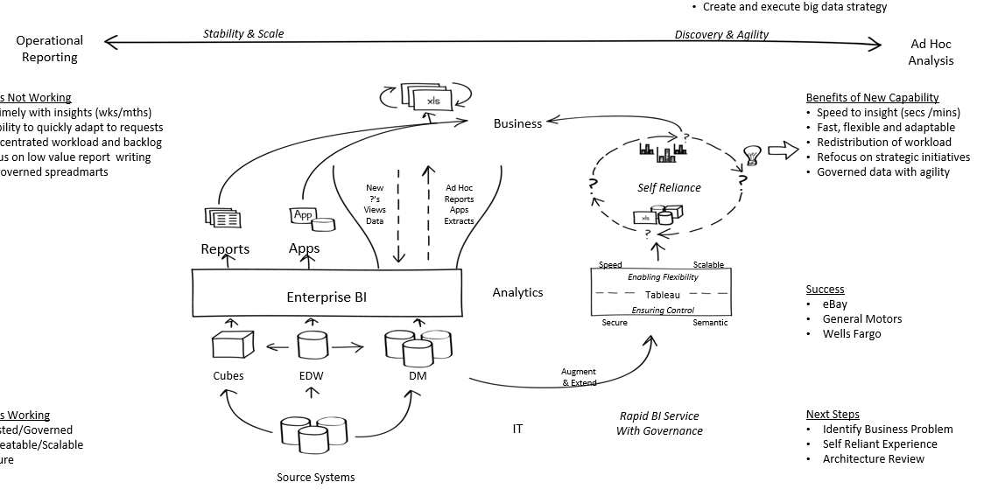

Slide 14
Today’s Lesson: How Data works in Large Orgs Getting Data to Tableau Once Data is in Tableau Hands On – Survey Data Homework

Slide 15
What is a database?
An organized collection of data, that includes data structures
Relational (RDBMS)
Related data structures (tables) that represent entities
Supports transaction processing and data analysis (marts and warehouse)
Queried with SQL
Oracle, SQL Server, DB2, HANA, MySQL, Access, etc.
Multidimensional (Cube)
Optimized for summarization and analysis
Built with aggregations
Queried with MDX
Analysis Services, Essbase
Other Types
Hierarchical
Object Oriented
Hadoop

Slide 16
Elements of a Relational Database
Table
Collection of related data held in a structured format, usually representing an Entity.
Query
A piece of code sent to a database to retrieve data, typically written with SQL (Structured Query Language)
View
A stored query that is a database object
Stored Procedure
A batch of SQL statements that is executed as a subroutine compiled into a single execution plan, also a database object
Function
A relation that associates an input to a single output according to some rule and/or logical procedure
Data Types
Classification to identify one of various types of data that determines the possible values for that type and used to determine how to store the data

Slide 17

Tables
Tables store data and are the building blocks of databases
Player # | Player | Team | Position
1 | K Britt | STL | WR
2 | M Sanu | CIN | WR
3 | D McCourty | NE | CB
4 | A Davis | SF | OG
5 | A Vinatieri | IND | K
6 | B Cushing | HOU | LB
7 | R Wilson | SEA | QB

Slide 18
Relational (RDBMS)
Table
Stores data that represents an entity
Product
ProductId
SKU
ProductName
ProductDesc
Color
Size
Sales
CustomerId
ProductId
Quantity
Amount
Record
A single instance of a the entity in a table
Column / Field
Element of table that represents an attribute of the entity
Customer
CustomerId
FirstName
LastName
City
State
PhoneNo
Relationship
Two tables that are associated and that help describe records in each
Notes:
Column
Comprise a record
Has a single data type per column / field

Slide 19
Elements of a Relational Database
Table
Collection of related data held in a structured format, usually representing an Entity.
Query
a piece of code sent to a database to retrieve data, typically written with SQL (Structured Qyerty Langyage)
SELECT fields
FROM table
WHERE filter
View
A stored query that is a database object
Stored Procedure
A batch of SQL statements that is executed as a subroutine compiled into a single execution plan, also a database object
Function -
Data Types
classification identifying one of various types of data, such as real, integer or Boolean, that determines the possible values for that type and used to determine how to store the data

Slide 20

Keys
Product
ProductId
SKU
ProductName
ProductDesc
Color
Size
Primary Key
Field the uniquely identifies each record, usually found in a dimension table.
Typically doesn’t have a business meeting (Surrogate Key)
Sales
CustomerId
ProductId
Quantity
Amount
PK
FK
FK
Foreign Key
Field that relates to Primary Key in another table. FK is usually in a fact table.
Customer
CustomerId
FirstName
LastName
City
State
PhoneNo
PK

Slide 21
Types of Joins
EMPLOYEE TABLE
Employee | DeptID
Frank | 33
Mark | 31
Beth | 34
John | NULL
DEPARTMENT TABLE
DeptID | DeptName
31 | Sales
32 | Marketing
33 | Engineering
34 | Clerical
Inner Join
Only where both tables match
Employee | DeptID | DeptID | DeptName
Frank | 33 | 33 | Engineering
Mark | 31 | 31 | Sales
Beth | 34 | 34 | Clerical
Left Outer Join
All records from Left table &
only where Right table matches
Employee | DeptID | DeptID | DeptName
Frank | 33 | 33 | Engineering
Mark | 31 | 31 | Sales
Beth | 34 | 34 | Clerical
John | NULL
Employee | DeptID | DeptID | DeptName
Mark | 31 | 31 | Sales
 |  | 32 | Marketing
Frank | 33 | 33 | Engineering
Beth | 34 | 34 | Clerical
Right Outer Join
All records from Right table
& only where Left table matches
Employee | DeptID | DeptID | DeptName
Frank | 33 | 33 | Engineering
Mark | 31 | 31 | Sales
Beth | 34 | 34 | Clerical
John | NULL
 |  | 31 | Marketing
Full Outer Join
All records from both tables

Slide 22
Cardinality
The uniqueness of values in a table & relationship
One-to-One
Single record in base table relates to a single record in the joined table
Employee
EmployeeID | Department
100 | Finance
101 | Marketing
102 | IT
Person
EmployeeID | PersonID | PersonName
100 | 233 | Joe
101 | 234 | Frank
102 | 235 | Ray
Order
CustomerID | Amount
1 | $20
2 | $30
1 | $15
3 | $25
2 | $18
One-to-Many
Single record in base table relates to more than one record in joined table
Customer
CustomerID | CustName
1 | ABC Corp
2 | XYZ Inc
3 | Qwerty
Many-to-Many
More than one record in base table relates to more than one record in joined table
"M:M Resolver Table"
PlayerID | TeamID
1 | 6
1 | 7
2 | 6
2 | 8
Team
TeamID | TeamName
6 | Mariners
7 | Yankees
8 | Tigers
Player
PlayerID | PlayerName
1 | R. Cano
2 | A. Jackson

Slide 23
Granularity
Level of detail or scale of the records in a table
Date | Sale Amount
Sept 1 | 2000
Sept 2 | 2500
Sept 3 | 1800
Month | Quota Amount
Sept | 150000
Oct | 180000
Nov | 165000
City | Population
Dallas | 1.257K
Austin | 885K
Miami | 417K
Tampa | 352K
State | Area
Texas | 286K mi²
Florida | 65K mi²

Slide 24
Normalization
The process of organizing the fields and tables of a relational database to minimize redundancy
Denormalized
Denomalized better for reporting (Data Warehouse / Mart)
Normalized better for transaction processing
Student# | Name | Teacher | Class# | Class | Room#
123 | Frank | Smith | 1000 | History | 102
124 | Joe | Jones | 1001 | English | 209
123 | Frank | Johnson | 1002 | Physics | 300
124 | Joe | Johnson | 1002 | Physics | 300
There are several levels of normalization
(ie: 1NF, 2NF, 3NF)
Normalized
Student# | Name
123 | Frank
124 | Joe
Student# | Class#
123 | 1000
123 | 1002
124 | 1001
124 | 1002
Class# | Teacher
1000 | Smith
1001 | Jones
1002 | Johnson
Class# | Class
1000 | History
1001 | English
1002 | Physics
Class# | Room#
1000 | 102
1001 | 209
1002 | 300

Slide 25
Functions
Scalar
Returns single value
Table
Returns a table
Deterministic
Returns the same results for the same input (ie: cosine)
Non-Deterministic
Returns different results
(ie: username or current time)
User Defined
Created by a person with code; as opposed to built-in (out-of-box)

Slide 26
Indexing
A data structure that improves the speed of data retrieval operations on a database table
Cust Name | Pointer
Frank
Joe
Debbie
Mary
Cust Name | Address | City | State | Zip | Birth Date | Married | Cust Type | First Purchase
Frank | 123 Main St. | Seattle | WA | 92382 | 13-Mar-78 | Y | Online | 22-Jan-13
Joe | 45 Maple Ave. | Austin | TX | 58384 | 17-Jun-83 | Y | Online | 23-May-12
Debbie | 32 Broadway | Denver | CO | 76934 | 12-Aug-87 | N | Prospect
Mary | 234 Fifth Ave. | Chicago | IL | 49345 | 10-Oct-85 | Y | Inperson | 7-Dec-12
Clustered / Non-Clustered
Clustered – same order as table
Non-clustered – arbitrary order
Covering
Index that contains all the fields for a query

Slide 27
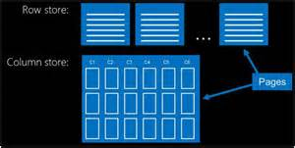
Row Store vs. Column Store

Slide 28
SQL (Structured Query Language)
SELECT fields
FROM table
JOIN other-table ON matched-fields
WHERE filter
GROUP BY aggregated-fields
HAVING filter-aggregated-fields
SELECT customer_name, SUM(sales)
FROM Sales S
INNER JOIN Customer C on S.custid = C.custid
WHERE Cust_Loc = “USA”
GROUP BY customer_name
HAVING SUM(sales) > 10000

Slide 29
More on SQL
UNION
Combine results of two queries vertically
Can be UNION or UNION ALL
SUBQUERY
SELECT query that is embedded in the main SELECT statement
DATA MANIPTULATION LANGUAGE (DML)
INSERT, UPDATE, DELETE
Modify data in a table
DATA DEFINITION LANGUAGE (DDL)
CREATE, DROP, ALTER
Defines data structures

Slide 30
Sub-Queries
SELECT Ord.SalesOrderID, Ord.OrderDate,
(SELECT MAX(OrdDet.UnitPrice)
FROM AdventureWorks.Sales.SalesOrderDetail AS OrdDet
WHERE Ord.SalesOrderID = OrdDet.SalesOrderID) AS MaxUnitPrice
FROM AdventureWorks2008R2.Sales.SalesOrderHeader AS Ord
SELECT Name
FROM AdventureWorks2008R2.Production.Product
WHERE ListPrice in
(SELECT ListPrice
FROM AdventureWorks2008R2.Production.Product
WHERE Type = 'Bolts')
SELECT Ord.SalesOrderID, Ord.OrderDate, Mup.UnitPrice
FROM AdventureWorks2008R2.Sales.SalesOrderHeader AS Ord
Inner Join (SELECT Ord.SalesOrderID , MAX(OrdDet.UnitPrice) as UnitPrice
FROM AdventureWorks.Sales.SalesOrderDetail AS OrdDet
WHERE Ord.SalesOrderID = OrdDet.SalesOrderID
GROUP BY Ord.SalesOrderID)
AS Mup on Mup. SalesOrderID = Ord. SalesOrderID

Slide 31
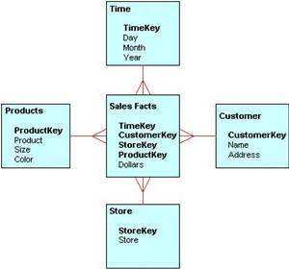
Facts, Dimensions, Star Schemas
Fact
An entity of something that happened
Contains foreign keys to dimensions and measures
Fact table without measures is a factless fact table.
Center of star-schema
Dimension
Entities which describe the fact (what, who, when)
Surround fact in star schema
Contains primary key and descriptions
Used to aggregate or filter

Slide 32
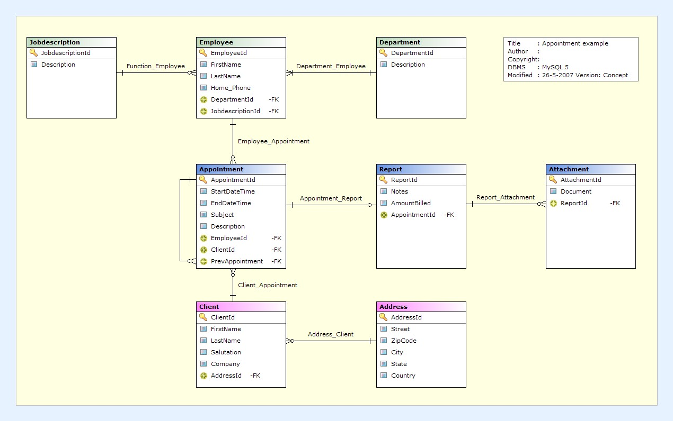
Entity-Relationship Diagram (ERD)
Diagram that displays the table layout of a database
Maps the relationships between tables/entities
Displays cardinality and “if optional”
Also known as a “Data Model”

Slide 33
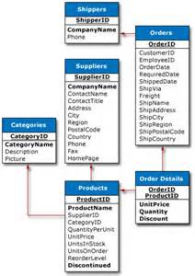
OLTP vs OLAP / Data Warehouse
OLAP – On Line Analytical Processing
Data Warehouse / Data Mart
OLTP – On Line Transaction Processing
Notes:
OLAP
Optimized to read large number of records, usually in a sequential order
Data can be aggregated and manipulates
Denormalized & Star/Snowflake schemas
ie: Time series analysis (ie: Y-O-Y Revenue Growth)
OLTP
Optimized to CRUD single or few records
Maintain data integrity
Normalized
ie: Single business transaction (ie: Order Entry)

Slide 34
Modern data drives need for a new generation of databases
Application Specific Databases
Limited to 1 application
Relational
Databases
Application independent
Scale-up architecture
Structured data only
Schema-on-write
Limited data processing
High cost
Cubes/
OLAP
Multi-dimensionality
Clean, structured views
Pre-Aggregated
Very High Cost!
Hadoop & NoSQL Databases
Structured & Unstructured
Massive scale – scale-out
Schema-on-read
Storage with Compute
Low cost
Notes:
Today’s use cases are driving the NEED for a new generation of databases
In the not so distant past, we used Application Specific Databases where data was not easily reused across applications
Then came the era of the Relational Database.
Relational databases have a lot of limitations relative to Hadoop & NoSQL
They have a scale-up architecture. They can only handle structured data. They are schema-on-write. They have limited data processing capabilities. And they are expensive.
That said, relational databases are still very relevant as a transaction source, and they will continue to be
It’s just that relational databases are DECLINING as a Big Data DESTINATION. Companies are RIGHT-SIZING their Relational DBs
Hadoopo and NoSQL Databases on the other hand invite you to store ALL OF YOUR DATA – both structured and unstructured.
They are designed to be distributed with a scale-out architecture, meaning when you scale you just add another BOX instead of getting a BIGGER BOX
They allow you to be more AGILE They allow for SCHEMA-ON-READ – this means you don’t have to actually DEFINE your schema UNTIL you are ready to analyze it
They combine STORAGE together with COMPUTE
It’s CHEAPER!!!

Slide 35
STRUCTURED
POS DATA | CRM | FINANCIAL DATA | LOYALTY CARD DATA | TROUBLE TICKETS
EMAIL | PDF FILES | SPREAD SHEETS | WORD DOCS | RFD TAGS
GPS | WEB LOG DATA | PHOTOS | SATELLITE IMAGES | SOCIAL MEDIA DATA
BLOGS | FORUMS | CLICK-STREAM DATA | VIDEOS | XML DATA
MOBILE DATA | WEBSITE CONTENT | RSS FEEDS | AUDIO FILES | TRAN-SCRIPTS
UNSTRUCTURED
Notes:
I’m here to tell you that big data is not new. Yet, with all the hype these last few years around these two little words, you’d think we’ve discovered the Holy Grail. Let me share with you the dirty little secret about big data: it’s just data—the same data we’ve had for decades.
They say that 20% of the data we deal with today is structured data (see examples in orange boxes above). I also call this traditional, relational data. The other 80% is semi-structured or unstructured data (examples in blue boxes), and this is what I call “big” data.
Are any of these blue-box data types new? Of course not. We’ve been collecting, processing, storing, and analyzing all this data for decades. What we haven’t been able to do very well, however, if at all, is mix the orange- and blue-box data together.
So here’s what’s new: We now have the technologies to collect, process, store, and analyze all this data together. In other words, with Hadoop, we can now mix-&-match the orange- and blue-box data together – at a fraction of the cost and time of our traditional, relational systems. You can’t do that with your data warehouse.

Slide 36
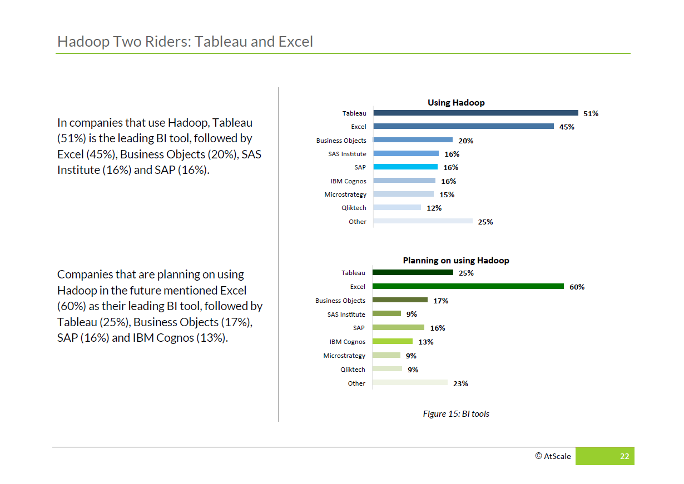
Tableau is a preferred choice for BI on Big Data
Notes:
Tableau has a rich history of investments in Big Data. We invested ahead of the adoption curve in Big Data and those investments have paid off in the adoption of our tool for Big Data analytics.
These investments include data connectivity to both Hadoop and NoSQL platforms, and both on-premise and the cloud.
Our engineering investments and vision aligns well with how the overall data landscape is evolving.
The new normal is that many customers are dealing with a diverse set of Big Data technologies. Technologies such as Hadoop and Spark have become a part of the data architecture alongside data warehouses for their ability to store and process data.

Slide 37


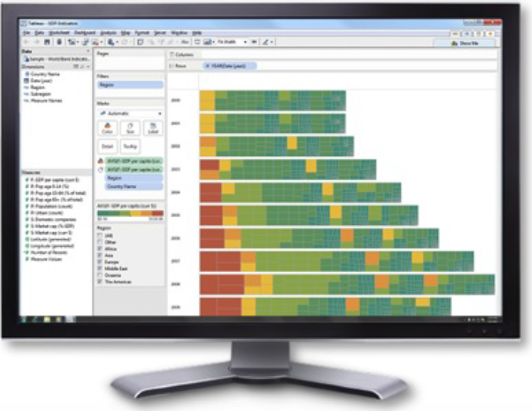


Tableau connects to Hadoop & Spark through an ODBC interface
Application
ODBC Driver
Data
HiveQL
Impala SQL
Spark SQL
SQL-92
Driver Implementation
ODBC Interface
Notes:
Tableau uses drivers leveraging the Open Database Connectivity (ODBC) programming standard as a translation layer between SQL and SQL-like data interfaces provided by these Big Data platforms. For Hadoop, this includes interfaces such as Hive Query Language (HiveQL), Impala SQL, and Spark SQL.
To achieve the best performance possible, we custom tune the SQL we generate as well as push down aggregations, filters and other SQL operations to the big data platforms.

Slide 38
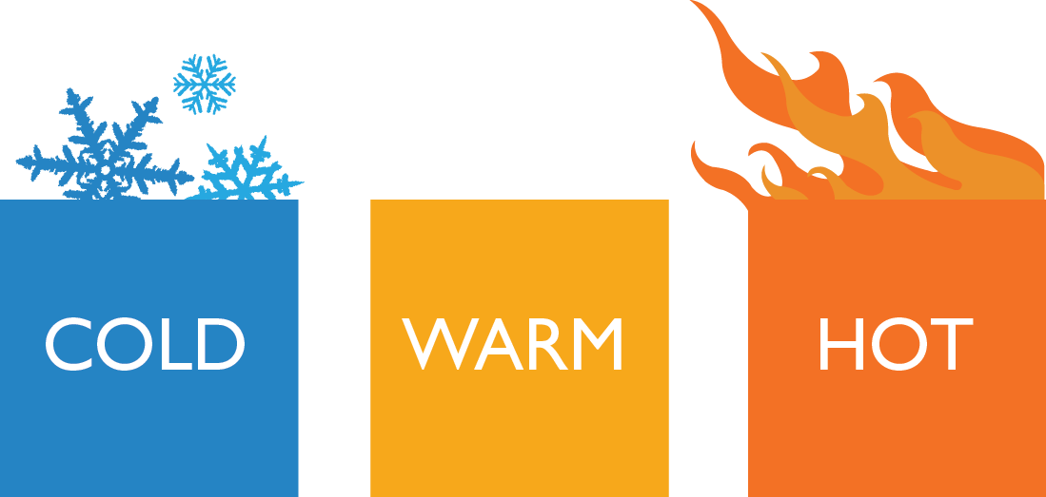
Cold, Warm, Hot Strategy
Notes:
Cold, Warm, Hot represents three tiers of data
Each Tier varies by:
1. The amount of data and level of aggregation
2. The speed of access required
3. How frequently you need to access the data

Slide 39



Cold, Warm, Hot Strategy
Data
Size
Hadoop
Analytical DB
Relational DB
Tableau Data Extracts
Performance
Large data (raw or prepared)
Prepared data
Aggregated data
Notes:
This chart is just a generalization to help understand the different tiers of data and data access
Hadoop is traditionally the “Cold”. You could either be exploring the raw data or working off of a prepared view.
Although it is traditionally slow, later we will talk about ways to accelerate data access with modern SQL-on-Hadoop engines
Relational databases can be seen as your “Warm”. Typically, you are working from prepared views of the data and you need fairly fast access
Lastly, you have in-memory Tableau Data Extracts as well as other fast analytical databases.
These extracts are solely used to back your Tableau dashboards

Slide 40



































Data Storage
Relational
Analytical / MPP
Cloud
Application
Unstructured / NOSQL
OLAP

Slide 41













Data Integration
Data Federation & Virtualization
Enterprise Extract Transform Load (ETL)

Slide 42

Cold – Hadoop Hive
Hadoop
Use Case
Data Exploration/Mining
Ad-Hoc Report Conceptual Modeling
Technologies
Hive on MapReduce – Cloudera, Hortonworks, MapR, Amazon EMR, and others
Hadoop
Ingestion:
Apps & Streams
HDFS
Hive
Notes:
Hadoop is a great place to capture and store all of your information
There are two main use cases that I hear about from customers:
1. In the Data Exploration/Mining use case, customers will simply use Tableau as a way to understand general trends and outliers of the data. Tableau is an easy to use tool to give you quick insights into your data
2. In the Ad-Hoc Report Conceptual Modeling use case, customers will use Tableau to figure out what parts of the data they actually want to use in preparing a more finalized view of the data
Technologies for Hive on MapReduce include Cloudera, Hortonworks, MapR, Amazon EMR and others

Slide 43

Challenges: Query speed
minutes
Hive on MapReduce
sub-minute
Hive on Tez or
Hive on Spark
sub-second
Notes:
The primary challenge with analytics on Hadoop and Hive on MapReduce has always been query speed.
When Hadoop started, Hive was the primary SQL interface, however performance was painfully slow
Innovations to the execution engine such as Hive on Tez or Hive on Spark have significantly improved the speed
It’s still a challenge to get down to the level of sub-second or several second responses
Which is important, because people don’t want to consume data slowly
A study was performed to understand what the maximum tolerable time is that people are willing to wait on the web, and the answer that they found in the study was 2 seconds

Slide 44

Impala Customer Story:
Bombay Stock Exchange
Applica-tion
Bombay Stock Exchange is the largest in India
Seeking to analyze stock information data
Tech-niques
50B rows aggregated to 4B
Extensive data partitioning
Eliminate joins, denormalize tables
Monitor long running queries
Data Env. & Infra.
Impala 2.0 running on 20 nodes of CDH 5.3.2
Each node: 16 cores, 128 GB RAM, 3 TB storage
50B rows of raw data, 27 TB data compressed
Results
2-5s for most queries on 4 billion records (1.4 TB in size) on live Impala queries
30-60s queries for aggregations with millions of marks
Very satisfied customer
Notes:
From: Prashant Momaya Sent: 21 July 2015 23:01 To: APAC Presales Subject: An Experience - Bombay Stock Exchange
Very often I face the question that is some variation of “what is the largest dataset Tableau can manage with decent performance” or “Tableau is really slow” – and I am sure many of us may have faced the same questions as well. Very recently I had a chance to work with Tableau on some really large datasets at the Bombay Stock Exchange (BSE) which is India’s largest stock exchange. I was getting responses in the 2-5 second range on a data set that was 1.4 TB in size ~ 4 billion records – even for views that had millions of marks the response times were still in the 30-60 second range in many cases. This triggered an instant reaction – how do they make this possible?
Over the last year of working with Tableau has been an amazing learning for me and I wanted to put down some of the thoughts that have been forming over many customer & prospect interactions. I am sure many of us will have already mastered these (you just have to read Alan’s brilliant whitepaper on designing efficient workbooks for this – there is no need to meet any customers/prospects!) but nevertheless J.
Let me start with what the BSE environment looks like
[if !supportLists]§ [endif]Data Source (Live connection)
[if !supportLists]o [endif]Impala 2.0 on Cloudera Hadoop 5.3.2 (20 nodes, each node is 16 Cores, 128 GB RAM, 3TB of Storage) ~ completely open source (i.e. $0.0 spent on software licensing for the data infrastructure, they only paid for hardware, services and for Tableau Licenses)
[if !supportLists]o [endif]Size of smallest table that matters: 1.4 TB compressed (a little more than 4 billion records as of last week)
[if !supportLists]o [endif]Size of largest table that matters: 10.7 TB compressed (~50 billion records)
[if !supportLists]o [endif]Total data in the cluster: ~27 TB compressed
[if !supportLists]§ [endif]Tableau
[if !supportLists]o [endif]Tableau Desktop 9.0 on 32-Bit Windows PCs (Yes, 32-Bit! It is their standard, they don’t like to pay for software unless they really need to)
[if !supportLists]o [endif]Tableau Server 9.0 with 10 interactors
Here are a few things that I learnt over the last year and were superbly reinforced at the BSE
[if !supportLists]1. [endif]Data side infrastructure is critically important when you are connecting live – you cannot (and should not) expect a little Honda Brio <substitute with your own version of a small hatchback> to pull a semi-trailer effectively. Before you start anything “live” be aware of how the data source is going to pull this load through, and interactively so.
[if !supportLists]2. [endif]Have a good understanding of what data attributes are important for analysis and what attributes are not significant. BSE distilled the essence of the 50b row table into 4b rows by understanding what data and what attributes do not meaningfully impact analysis and then filtering those out. This requires a good appreciation/understanding of the business and the data.
[if !supportLists]3. [endif]It is good to understand how the underlying data system delivers performance – sometimes the best people to give you an understanding of the data source are the customer/prospect – I got a crash course on the most important things that affects performance in Hadoop in 30 minutes, and sometimes those are the only thing you need to know! One of those things is partitioning (the reasons for which are not unlike typical RDBMS partitioning though the mechanics are a bit different). BSE partitioned based on 2 of the most frequently queried attributes/dimensions and that worked miracles for the end user on Tableau Desktop.
[if !supportLists]4. [endif]Where possible create a large de-normalized table that Tableau can plug directly into – joins can be expensive overheads, avoid them if/when possible (especially on the so called big-data sources or even in RDBMSs where large Tables are to be joined). The performance difference between a pre-created table and an on-the fly join can be substantial. BSE ran a Pig (that’s what the ETL tool in Hadoop is called) job every night to produce a few large de-normalized tables (pre-joined, materialized) that the users could work on directly. This was good enough for most users and delivered amazing performance gains.
[if !supportLists]5. [endif]Regular monitoring of performance at the data source end – the BSE Cloudera Admin reviewed “long” running Tableau fired queries every few days and decided if they were one-off or were likely to be fired more often. They would then determine a course of action to have better user experience on the Tableau side – for example data growth will result in some currently fast queries slowing down, how do they scale for that – i.e. do they add new nodes to the Hadoop cluster. It is important to remember that performance has to be engineered and is not a given – they just reinforced that concept for me once again. Russell spoke about a similar concept for the Tableau Server at the QBM.
[if !supportLists]6. [endif]What is also important is that you tune only what mattered and left alone what did not – BSE’s motto was to engineer/optimize for an application and not for perfection. This pragmatic approach helped focus efforts from the Tableau user’s point of view and not from a technical “I have the biggest/baddest/best Hadoop installation in the universe that no one uses” perspective
It all distills for me into what I call data physics – there are only 3 areas that can be acted on to influence performance – similar to the 3 Newton’s laws of motion that we learnt in school, here are the 3 (interrelated) questions to ask either the prospect or yourself…
[if !supportLists]1. [endif]Do you have sufficient infrastructure/hardware to deal with the kind of data that will be analyzed? ~ Law of inertia J, nothing moves till there is sufficient force applied to move it
[if !supportLists]2. [endif]Have you chosen an underlying data source that matches your performance aspirations, and have you engineered it for interactive performance? ~ law of dynamics, Force = mass * acceleration J
[if !supportLists]3. [endif]Have you created your Tableau vizzes so that the queries run efficiently? ~ For every action (viz) there is an equal and opposite reaction (from the data source) J
All this of course has been beautifully explained/elaborated by Alan in the Designing Efficient Workbooks whitepaper. These are my notes from the field that merely reinforce what he says and the many threads in the CSH say.
Nothing in here, of course can describe how totally awesome it felt to make 4 billion rows of data dance to your little mouse clicks!!! J
Cheers
Prashant Momaya c: +91 98200 51307
e: pmomaya@tableau.com
skype: pmomaya-tsi

Slide 45

Impala Customer Story:
Visa
Applica-tion
Analyze transaction data for analysis, fraud detection and chargeback investigations
Tech-niques
Hardened cluster – upgraded CDH and optimized resource management of cluster
Leveraged performance improvements in Tableau 9.X
Data Env. & Infra.
Impala 2.0 running on 100 nodes of CDH 5.2.1
Tableau 8.3 -> 9.X
70M records, 200 columns mostly text, ~25 GB
Results
Live Impala queries went from 1-10 minutes down to < 7s
Converted almost exclusive use of extracts to live Impala connections

Slide 46

Certain pitfalls must be avoided
Hadoop
Data blending large datasets
Avoid large Hadoop dataset to second dataset blending
Executed on the Tableau client side
Unnecessary joins
Imperfectly implemented on many big data systems
Connections with huge number of schemas and columns
Inefficient formulas
Notes:
Title & Copy

Slide 47


Leverage a multi-tiered approach based on your data
Aggregated
data
TDE
+
Hadoop
Impala
Spark SQL
Hive LLAP
Presto
Drill
Raw data
(large)
Ingestion:
Apps & Streams
HDFS
Prepared
data
Fast analytical database
Notes:
You can use multiple tiers together in the same Tableau Dashboard so that each tier has a different level of aggregation for the data.
For instance, you can access the raw data directly in Hadoop when you need the greatest level of detail in the data, a curated view that’s stored in a fast analytical database, and a highly aggregated Tableau Data Extract when working with the top-level data

Slide 48
Warm – Relational DB
Use Case
Data/Reports Migrated from Hadoop
Regularly Analyzed Data
Production Reporting
Technologies
Microsoft SQL Server
Oracle
MySQL
PostgreSQL
Others
Hadoop
Ingestion:
Apps & Streams
HDFS
Hive
Relational
DB
Notes:
Warm is generally your relational database
This can include data/reports that are migrated from Hadoop. This is for faster speed
Relational databases can be a great repository to hold data that’s regularly analyzed data and often-accessed. This is a good strategy if you want to off-load the work from Hadoop.
Relational databases for production-level reporting is a common use case depending on the size of your data. Customers often will use a relational database as the single source of truth for data.
The most popular of these databases include Microsoft SQL Server, Oracle, MySQL and Postres

Slide 49
Hot – TDEs & Analytical DBs
In-
Memory
Technologies
Tableau Data Extract
HP Vertica
Teradata Aster
Exasol
Pivotal Greenplum
Use Case
BI Applications
Speed up specific elements in a dashboard
Hadoop
Ingestion:
Apps & Streams
HDFS
Hive
+
TDE
Notes:
Then you have Tableau Data Extracts and Fast Analytical Databases
These types of databases typically are in-memory, and have a columnar format. This enables BI applications to have the fastest performance possible when performing aggregations and other analytical functions.
Besides Tableau Data Extracts, there are a number of fast analytical databases including HP Vertica, Teradata Aster, Exasol and Pivotal Greenplum

Slide 50
Leverage an interactive query engine
Impala
Spark SQL
Hive LLAP
Presto
Drill
Fast analytical database with distributed query engine
Interactive analytics - fastest SQL-on-Hadoop performance
Single sign-on support
Named connector in Tableau
Hadoop
Ingestion:
Apps & Streams
HDFS
Impala
Spark SQL
Hive LLAP
Presto
Drill
Notes:
Impala is a fast analytical database with a specialized distributed query engine
Impala is purpose-built for analytical queries. It is also known to have the fastest SQL-on-Hadoop performance today.
It leverages the Hive metastore which holds the metadata definition for the tables that Tableau reads
Tableau supports a number of security options with Impala including single-sign-on with user delegation
Impala is also a named connector in Tableau

Slide 51
General Advice
Use Tableau Native Drivers
Support 40+ data sources and optimized
Use ODBC for all other cases
Test as close to data source as possible
Notes:
Numbered List

Slide 52
Database Management
Indexes
Make certain there are indexes on any table joins
Make certain there are indexes on columns used in quick filters
Discrete Date Filters can cause performance issue in some DBs
Gather Statistics
NULLS
Having NULL values in a dimension can reduce index effectiveness
Where possible, define dimension columns as NOT NULL
Especially Primary and Foreign Keys
Notes:
Numbered List

Slide 53
Database Management Cont.
Partitioning
On large data sets
Dimensions (time, region, category, commonly filtered)
Create Views
Utilizes DB optimizations
Perform Intensive Calculations on DB level (or ETL level)
Temp Tables
Allow creation/drop of Temp Tables
Tableau can utilize temp tables for:
Creating ad-hoc groups and sets
Applying context filters
Performing data blending
Notes:
Numbered List

Slide 54
Web Data Connectors
The Tableau Web Data Connector (WDC) is essentially the Extract API embedded directly into Tableau Desktop with javascript used as the wrapper to send data to it. This means that connector authors around the community can easily build Tableau connectors for any data source accessible via javascript but not currently listed in the native Tableau connections.
Quandl – http://www.theinformationlab.co.uk/data/quandl.html Boris Bikes – http://jdunkerleytableau.azurewebsites.net/Bikes Import.IO – http://connectors.poc.interworks.com/importio Mapbox Directions (car, bike & walking) – http://www.theinformationlab.co.uk/data/directions.html Fitbit – http://www.theinformationlab.co.uk/data/fitbit.html Moves – http://www.theinformationlab.co.uk/data/moves.html Strava – http://www.theinformationlab.co.uk/data/strava.html
Facebook - http://tableaujunkie.com/post/123558558693/facebook-web-data-connector
Twitter - http://tableaujunkie.com/post/119681578798/creating-a-twitter-web-data-connector

Slide 55
Twitter
http://ec2-52-10-150-250.us-west-2.compute.amazonaws.com/twittersearch/twitterwebconnect.html

Slide 56
Today’s Lesson: How Data works in Large Orgs Getting Data to Tableau Once Data is in Tableau Hands On – Survey Data Homework

Slide 57
File Extensions
TWB | Tableau Workbook | TDS | Tableau Data Source
TWBX | Tableau Packaged Workbook | TDE | Tableau Data Extract
TBM | Tableau Bookmark | TPS | Tableau Preferences File
Notes:
When it comes to data connections, I have several classifications that I keep in mind.
Live connection to the data source.
A static data source in a .twbx, created by saving a workbook with a live connection as a .twbx.
An extract that is made from a live connection to the data source. This gets the double-cylinder icon.
A “naked” extract – we can directly connect to a .tde file as a data source. This gets a single-cylinder icon and is a variation on the live connection, only it’s really a static connection because the raw .tde doesn’t have the information needed us to trigger a refresh. I don’t really recommend this unless you are very sure of what you’re doing, if the .tde changes that can case workbooks built on the naked extract to start throwing up errors, showing [Calculation_2987347315671] instead of your actual field names, etc. Use a .tds instead (a bit more about that below).
A connection to a Tableau Server Published Data Source – this has four subtypes, the first are variations of three types mentioned above – a passthrough live connection to the data source, an extract made from a live connection, or a naked extract, and the fourth is a “static” connection to the data source (which is what we get from a live connection to a data source when we leave the “Include External Files” option to it’s default of being checked, or make a connection to a static source where we Include External Files, there’s a failure mode in this that I’ll talk about further down in publishing).
An aside here: One way to think of .tds files is that they “wrap” any of the above connection types in metadata to make the connections re-usable, so instead of making the connection to the raw Excel file, SQL Server, Tableau Saved Data Source, etc. we “connect” to the .tds.

Slide 58
Join Types
The driver for the data connection determines which join types are available.
Left
Right
Full
Inner
Outer

Slide 59
Introduction
Most performance issues occur in the workbook
If we start with poor data performance it will make the workbook worse
Small number of records, bad data source can be hidden
With millions of records, slowness of a poor built workbook will be greatly amplified by a poor built data source
Notes:
Numbered List

Slide 60
“If it isn’t fast in the data source, it wont be fast in Tableau!”
Notes:
Quote

Slide 61
“If it isn’t fast in Tableau Desktop, it wont be fast in Tableau Server!”
Notes:
Quote

Slide 62
In Tableau Desktop
Joins in Tableau
Ensure joins are done on indexed fields
Assume Referential Integrity
Join culling – joins will only occur when needed
Connect to Views
No Custom SQL! - Create View instead
Few exceptions (Parameter Passing)
Files = Extracts
Convert all txt, csv, etc to a tde (tableau data extract)
Notes:
Numbered List

Slide 63
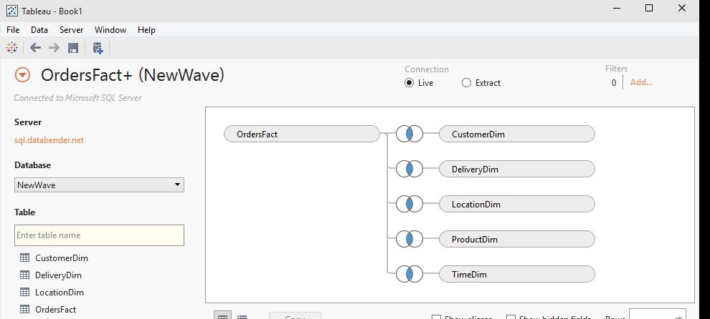
Join Culling
Join culling is used to improve query performance.
Join culling allows Tableau to query only the relevant tables instead of all tables defined in the joins. Custom SQL cannot leverage join culling.

Slide 64
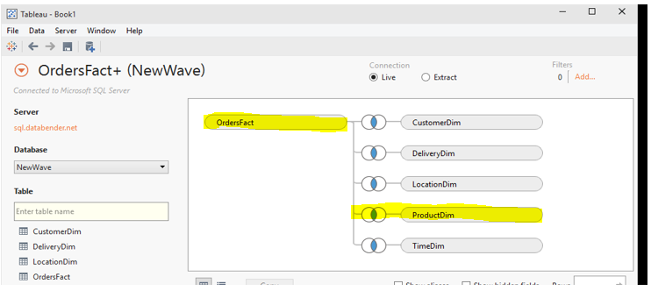
With Join Culling
SELECT [ProductDim].[Product Category],
SUM([OrdersFact].[Sales])
FROM [dbo].[OrdersFact] [OrdersFact]
INNER JOIN [dbo].[ProductDim] [ProductDim]
ON [OrdersFact].[Product ID] = [ProductDim].[Product ID]
GROUP BY [ProductDim].[Product Category]

Slide 65
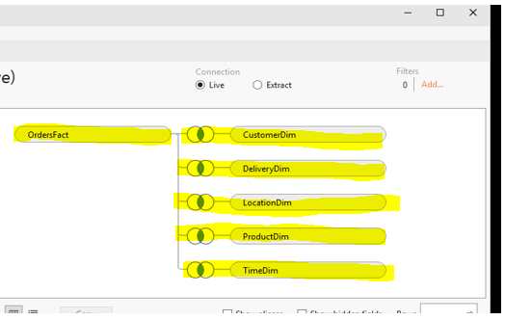
Without Join Culling
SELECT [ProductDim].[Product Category],
SUM([OrdersFact].[Sales])
FROM [dbo].[OrdersFact] [OrdersFact]
INNER JOIN [dbo].[CustomerDim] [CustomerDim]
ON [OrdersFact].[Customer ID] = [CustomerDim].[Customer ID]
INNER JOIN [dbo].[DeliveryDim] [DeliveryDim]
ON [OrdersFact].[Delivery ID] = [DeliveryDim].[Delivery ID]
INNER JOIN [dbo].[LocationDim] [LocationDim]
ON [OrdersFact].[Place ID] = [LocationDim].[Place ID]
INNER JOIN [dbo].[TimeDim] [TimeDim]
ON [OrdersFact].[Date ID] = [TimeDim].[Date ID]
INNER JOIN [dbo].[ProductDim] [ProductDim]
ON [OrdersFact].[Product ID] = [ProductDim].[Product ID]
GROUP BY [ProductDim].[Product Category]

Slide 66
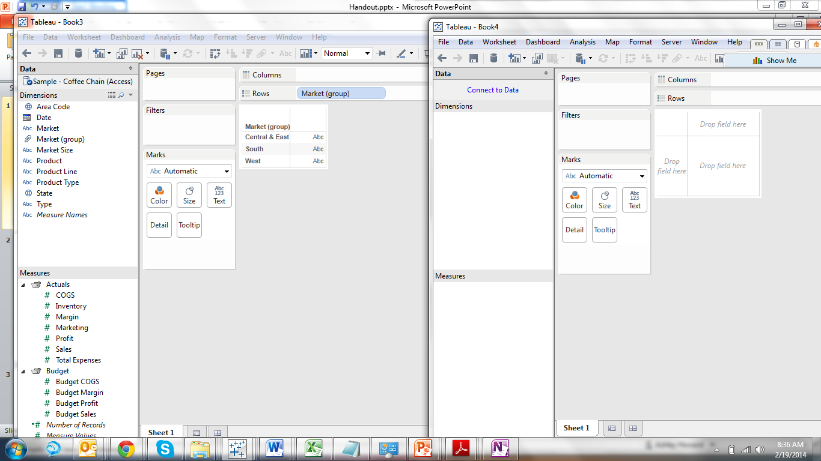
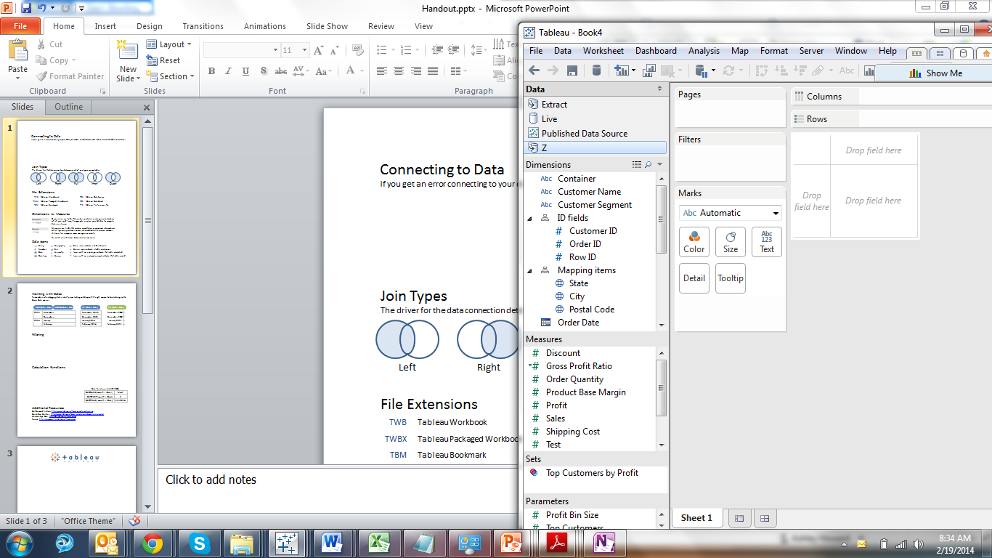
Connecting to Data
If you get an error connecting to your data, you may need to download a driver from the Tableau website.
Using Extracts
If working with large quantities of data, consider taking a sample set by applying a filter, using Top rows or a percentage sample in order to see your data prior to taking the full extract.
Using Live Connections
To improve performance, if the filter is unlikely to change, add your filters to the context (by right clicking on the filter). Filters that exclude Null values or remove 90%+ of your rows are prime candidates for context filters.

Slide 67
Published Data Source Types
The data sources below can be either extracts or live connections.
DATA
DATA
(Local) Data Source
Published Data Connection

Slide 68
Extracts – What are they?
A persistent cache of data that is written to disk and reproducible;
A columnar data store – a format where the data has been optimized for analytic querying;
Completely disconnected from the database during querying. In effect, the extract is a replacement for the live data connection;
Refreshable, either by completely regenerating the extract or by incrementally adding rows of data to an existing extract;
Notes:
Numbered List

Slide 69
Extracts – What are they? Cont.
Architecture-aware – unlike most in-memory technologies it is not constrained by the amount of physical RAM available;
Portable – extracts are stored as files so can be copied to a local hard drive and used when the user is not connected to the corporate network. They can also be used to embed data into packaged workbooks that are distributed for use with Tableau Reader;
Often much faster than the underlying live data connection.
Notes:
Numbered List

Slide 70
Why Use a Tableau Data Extract?
1. Not Possible
Notes:
Why Use a Tableau Data Extract?
My preference is to first consider using a live connection because extracting data adds another step to the data delivery chain. However there are many situations where that isn’t a workable solution, so Tableau has created Tableau Data Extracts to support situations where a live connection to the source is:
Not possible. Sometimes a Tableau viz can’t have live connection to a production system, for example when you want to share a viz with someone not inside your premises. The extract can be published (whether in a viz or as a published data source) to Tableau Server or Online, or saved in a Tableau packaged workbook (TWBX) or packaged datasource (TDSX), or sent “naked” as a TDE file.

Slide 71
Why Use a Tableau Data Extract?
1. Not Possible 2. Too Slow
Notes:
Too slow. There are a number of variations on this:
For example a production system is on a slow network connection so a TDE can be created locally and only have to go over the slow network.
Because data extracts are highly optimized for queries they can be much, much faster than a live connection. I regularly see 100x improvement in load times using Tableau data extracts over MS Access, to the degree that my muscle memory is tuned to making an extract as the first thing I do after connecting to an Access-based source.Note that older posts (prior to the release of Tableau v8.2) on extracts will talk about them being faster than raw Excel/text connections because at the time the “legacy” aka MS JET engine was used. That is no longer the case with the new Excel/text connector. The new connector takes advantage of Tableau’s data extract (data engine) technology to create a data extract in the background, that’s why the first connection can be slow and then creating an extract can be instantaneous.
The Tableau queries to the live connection might slow down operational queries too much, so having Tableau only query at scheduled extract refresh times is preferable.
Data volumes could be such that millions of records per week of raw data that would be too slow to run live Tableau queries on might be aggregated in a TDE down to dozens or hundreds per week based on some set of categories/dimensions in the data.

Slide 72
Why Use a Tableau Data Extract?
1. Not Possible 2. Too Slow 3. Record Volumes
Notes:
Unable to handle the record volumes. MS Excel is limited to 1M records, MS Access tops out anywhere in the 100s of thousands to couple M records depending on the complexity of the table, etc. whereas a TDE can potentially handle billions of records. Another case is situations where the data is stored in multiple tables (potentially across multiple data bases) and a UNION query is used to generate a result that is too big for a live connection but fine for a TDE.

Slide 73
Why Use a Tableau Data Extract?
1. Not Possible 2. Too Slow 3. Record Volumes 4. Exposing too much data
Notes:
Exposing too much data. There are four cases where extracts can effectively improve security by reducing what data is made available:
We can create extract filters on TDEs so only the necessary records are included.
We can set up the extract to only include fields used in the workbook, in other words we can exclude columns from the extract.
Extracts can be configured to aggregate the data and therefore hide record-level detail.
For file-based sources when we include the files in a TWBX it’s the whole file, so for an Excel file that means that every worksheet in that file is included in the TWBX. If we extract the data then only the necessary data for the workbook is in the TDE

Slide 74
Why Use a Tableau Data Extract?
1. Not Possible 2. Too Slow 3. Record Volumes 4. Exposing too much data 5. Unable to handle data volumes
Notes:
Unable to handle the data volumes. A related case is that since a TDE is highly compressed it can be a lot smaller than the original uncompressed source. I’ve seen people use TDEs instead of file-based sources to make distribution of packaged workbooks easier.

Slide 75
Why Use a Tableau Data Extract?
1. Not Possible 2. Too Slow 3. Record Volumes 4. Exposing too much data 5. Unable to handle data volumes 6. Calcs not supported
Notes:
Not supporting certain calculations. Tableau data extracts have generally supported more functions than any particular data source (with the exception of RAWSQL functions). One example is that in the “old days” before Tableau 8.2 with the new Excel/text connector we were stuck with the MS Jet engine for connecting with Excel & text files and that couldn’t handle COUNTD(), MEDIAN(), In/Out of Sets among other drawbacks, so we’d create an extract. Another example is that currently not all sources support the Level of Detail Expressions introduced in v9.0 and again we can work around that by creating an extract.

Slide 76
Why Use a Tableau Data Extract?
1. Not Possible 2. Too Slow 3. Record Volumes 4. Exposing too much data 5. Unable to handle data volumes 6. Calcs not supported 7. Too complex
Notes:
Unable to handle the complexity. There are various computations (such as using top and conditional filters, nested calculated fields, etc.) that TDEs can handle in combined ways that some data sources can’t. For example MS Access databases are one of my main data sources and in some Tableau worksheets if I switch from the TDE to the live connection the MS JET engine gives me a “query too complex” error.

Slide 77
Why Use a Tableau Data Extract?
1. Not Possible 2. Too Slow 3. Record Volumes 4. Exposing too much data 5. Unable to handle data volumes 6. Calcs not supported 7. Too complex 8. Multiple file-based sources
Notes:
Actually a situation where multiple file-based sources needed to be put together…with TDEs it’s possible to add data to an extract from multiple file-based sources, which can be handy when you are integrating data from various producers at different times. Tableau is working on improving this: At the 2015 Tableau Conference they demoed a feature for creating federated queries across multiple data sources (including server-based sources, other TDEs, etc.). From what I saw Tableau will be able to do this in a live connection, however I’m guessing that we’ll often want to be using TDEs for performance reasons.

Slide 78
Other Features of Data Extracts
Materialized Expressions
Access to Cloud Data Sources
Ability to publish to Tableau Public
Notes:
Other Features of Tableau Data Extracts
A few other advantages of TDEs are:
Materialized expressions. Tableau will “materialize” record-level calculations that use only fields from a single data source and are not dependent on run-time values — i.e. not using TODAY(), NOW(), USERNAME(), ISMEMBEROF(), or a parameter — as fully indexed & compressed fields in an extract. This can improve performance in many cases, for example when splitting name or address fields and/or creating datetime fields out of strings.
Access to cloud-based data sources. In order to make cloud-based sources such as Salesforce.com, Google Analytics, oData, and the Tableau Web Data Connectors useful for the kinds of at-the-speed-of-thought analytics that Tableau enables we have to use Tableau data extracts. Other cloud-based sources such as Amazon Redshift, Google BigQuery, and Microsoft Azure can be used as a live connection or extracted as needed.
Option to publish to Tableau Public. For performance reasons we can only use TDEs when publishing to Tableau Public.

Slide 79
When to Use Extracts
65
Files = Extract
Csv, txt, etc -→ .tde
Slow query execution
Try using an extract
Data Security
Extract a subset of information
Calculations
View not based on a parameter or filter change
Performance
# of Columns
Notes:
Numbered List

Slide 80
When NOT to Use Extracts
Well-built Cubes
Warehouse connections (Teradata)
Unless aggregated (test and compare)
Need real-time (live) data
Row level security required
Extremely large datasets (> 1B rows)
Always test Live vs Extract
Notes:
Numbered List

Slide 81
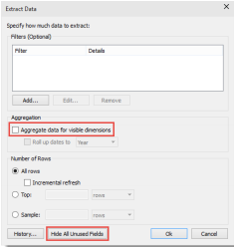
Aggregate Extracts
Create Summary Views
To only use columns needed
“Aggregate data for all visible dimensions” check box in Tableau Desktop’s Extract Data dialog box
Hide All Unused Fields
Dashboards using different levels of aggregation
Notes:
Numbered List

Slide 82
Alternatives to Custom SQL
Create/Connect to Views
Create Stored Procedures
Initial SQL (if supported)
Notes:
Numbered List

Slide 83
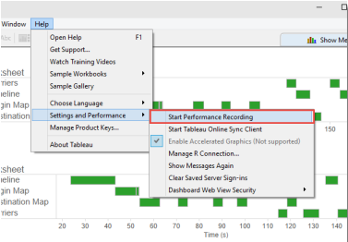
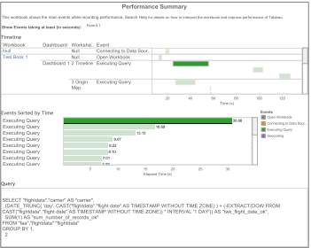
Performance Recordings
Tableau Desktop
Tableau Server
Use this information to see where improvements could be made
Notes:
Numbered List

Slide 84
Calculations
Use Native Features
Grouping dimension members together – consider using groups or sets;
Grouping measure values together into ranged bands – consider using bins;
Truncating dates to a coarser granularity e.g. month or week – consider using custom date fields;
Creating a set of values that is the concatenation of two different dimensions – consider using combined fields;
Changing the displayed values for dimension members – consider using aliases.
Notes:
Numbered List

Slide 85
Booleans
String Calcs are slow!
Integers and Booleans are faster than strings
Use Booleans for basic Logic
If you have a calculation that produces a binary result (e.g. yes/no, pass/fail, over/under) be sure to return a Boolean result rather than a string. As an example:
IF [Date]= TODAY() then “Today”
ELSE “Not Today”
END
This will be slow because it is using strings. A faster way to do this would be to return a Boolean:
[Date]=Today()
Then use aliases to rename the TRUE and FALSE results to “Today” and “Not Today”.
Notes:
Numbered List

Slide 86
String Searches
Imagine you want to be able to show all records where the product name contains some lookup string. You could use a parameter to get the lookup string from the user and then create the following calculated field:
IF FIND([Product Name],[Product Lookup])>0
THEN [Product Name] ELSE NULL END
This calculation is slow as this is an inefficient way to test for containment. A better way to do this would be to use the specific CONTAINS function as this will be converted into optimal SQL when passed to the database:
CONTAINS([Product Name],[Product Lookup])
However, in this case, the best solution would be to not use a calculated field at all, but rather use a wild card match quick filter.
Notes:
Numbered List

Slide 87
Parameters and Conditional Calcs
Parameters are a good way to allow the user to determine how a calculation is performed
As discussed, strings are slow
Use the ‘Display As’ feature
Then use it in a calculation like this:
IF [PARAMETERS].[DATE PART PICKER]=”YEAR”
THEN DATEPART(‘YEAR’,[ORDER DATE])
ELSEIF [PARAMETERS].[DATE PART PICKER]=”QUARTER”
THEN DATEPART(‘QUARTER’,[DATE]) … ELSE NULL END
VALUE | DISPLAY AS
YEAR | YEAR
QUARTER | QUARTER
MONTH | MONTH
WEEK | WEEK
DAY | DAY
Notes:
Numbered List

Slide 88
Parameters and Conditional Calcs
A better performing parameter would be an integer type with text labels, like this:
The calculation would then be as follows – see how the comparisons are numeric rather than string:
IF [PARAMETERS].[DATE PART PICKER]=1
THEN DATEPART(‘YEAR’,[ORDER DATE])
ELSEIF [PARAMETERS].[DATE PART PICKER]=2
THEN DATEPART(‘QUARTER’,[ORDER DATE]) .. ELSE NULL END
VALUE | DISPLAY AS
1 | YEAR
2 | QUARTER
3 | MONTH
4 | WEEK
5 | DAY
Notes:
Numbered List

Slide 89
Gather Requirements
Focus on the 80% of the questions you can answer easily, don’t get bogged down in edge cases
As people answer their simple questions they will move onto more sophisticated analysis
Consider the overlap that may exist in already published data sources
What is new about this data source
If two similar data sources exist, work to combine them to reduce Tableau Server resource use. Also simpler for users. Can be confusion with duplicative data sources.
Notes:
Numbered List

Slide 90
Data Feel and Experience
Use comments to describe your metadata
Use folders and hierarchies to organize your fields
Rename fields to be user friendly and easy-to-read
Hide fields that are not useful to reduce extract size
Create calculations everyone has agreed on (One Version of Truth)
Notes:
Numbered List

Slide 91
Maintenance and Change Process
Create a ‘Master’ workbook to make changes
Have a formal solution for who can make changes and how changes are approved
More than just one person considers potential impacts before the data source is changed
There are tradeoffs between allowing many to modify (which may require a more structured process) and having only a handful of analysts who can change (which can allow for quicker prototyping
Make sure new fields get organized and commented properly
Notes:
Numbered List

Slide 92


When to use extracts vs. live connections?
Extract Not recommended | Extract Recommended
When need to leverage database functionalities: Balance resource usage by sessions | When slow query execution (slow database)
When workbook uses pass-through RAWSQL functions | When using Custom SQL
When Real-Time analysis is required. | When Offline analysis is required
When Robust user-level security is required ̶ except extracts that have been published to Tableau Server | When Additional functionalities (set, rank, distinct, median) are needed. (MS JET Driver)
When massive data set is needed. (millions or billions of rows) | When smaller data set is needed (fewer columns/rows, aggregation)
 | When using Tableau Online or Reader

Slide 93
Extracts: Best Practices
Hide unused fields ̶ it reduces columns in the extract
Aggregate ̶ it decreases data extract size while retaining necessary level of detail
65
Performance
# of Columns

Slide 94
Things to know about queries
Query performance can be recorded
Use this information to see where improvements could be made

Slide 95
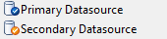
Blending
Data Blending allows you to connect multiple data sources together. Tableau automatically gives you a link if the secondary data source contains a similarly named field. To manually create a link go to Date>Edit Relationships.
Linked Field – Tableau acts like there is a left join.
Unlinked Field – Tableau ignores the relationship.

Slide 96
Things to know about Blending
Blend data when you have more than one data source
Join data when you use two data connections from the same data source – It improves performance and filtering control
Cardinality of the blending field(s) matter – Blending queries the data from both data sources at the level of the linking fields and then merges the results of both queries together in memory.
Avoid blending on dimensions with large numbers of unique values (e.g. Order ID, Customer ID, exact date/time, etc)

Slide 97
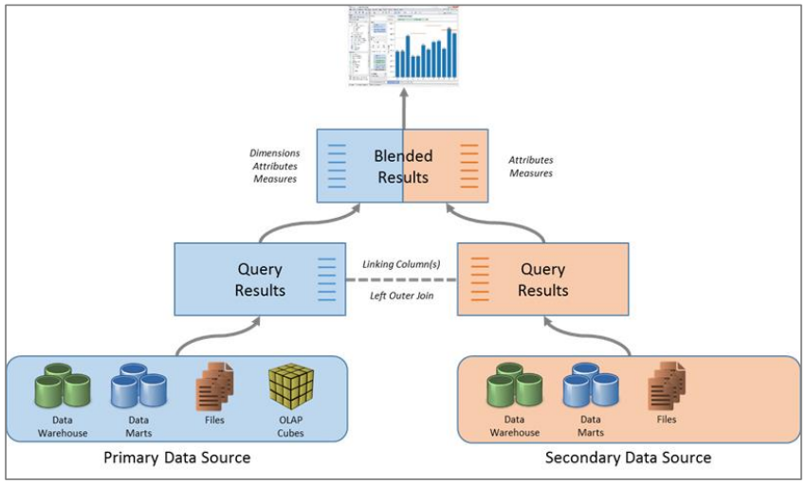
Blending

Slide 98
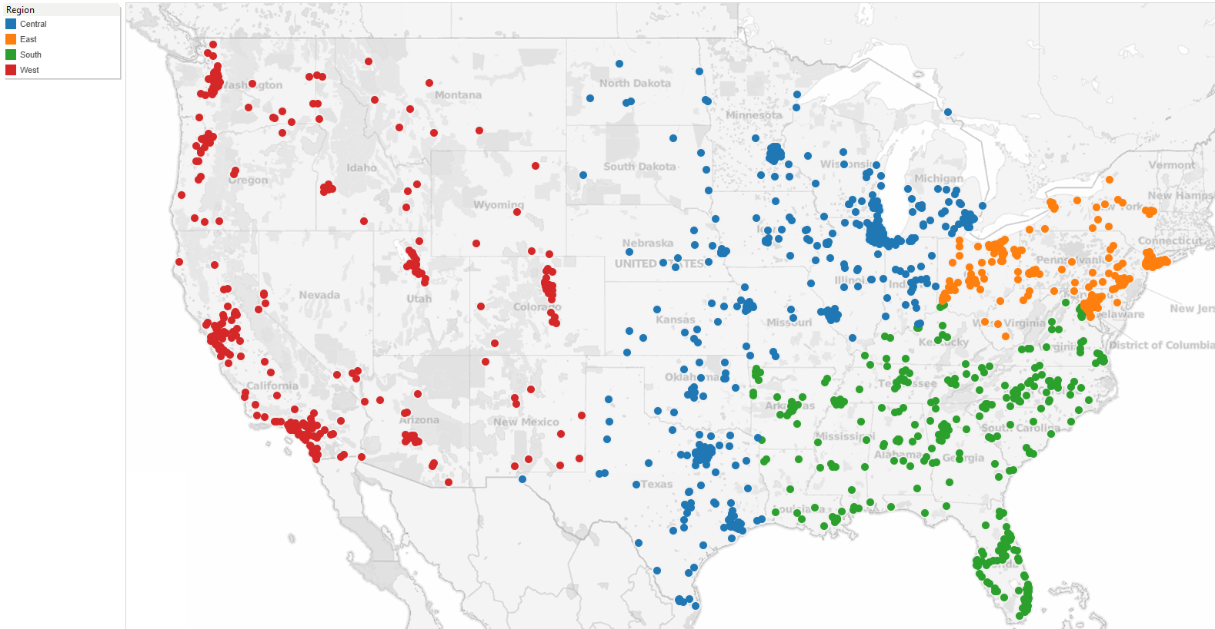
Filtering categorical dimensions
Consider the following visualization – a map of The United-States with the marks for each postcode:

Slide 99
Filtering categorical dimensions
There are several ways we could filter the map to just show the postcodes for the Western region (the red dots):
We could select all the marks in the Western region and keep-only the selection
We could select all the marks outside of the Western region and exclude the selection
We could keep-only on another attribute such as the Region dimension
We could filter by range – either on the postcode values or the latitude/longitude values.

Slide 100
Filtering categorical dimensions
Options (a) and (b) will perform poorly.
They can even be slower than the unfiltered data set.
Because they are expressed as a discrete list of postcode values that are filtered IN or OUT by the database either through a complex WHERE clause or by joining with a temp table that has been populated with the selection.

Slide 101
Filtering categorical dimensions
Options (c) is fast.
Because the resulting filter (WHERE Region=”West”) is very simple and can be efficiently processed by the database.
However this approach becomes less effective as the number of dimension members increase.

Slide 102
Filtering categorical dimensions
Options (d) is fast too.
Because using the ranged filter also allows the database to evaluate a simple filter clause resulting in fast execution.
(WHERE POSTCODE >= 59000 AND POSTCODE < 60000
OR POSTCODE >= 80000 AND POSTCODE < 100000 )
However this approach, unlike a filter on a related dimension, doesn’t become more complex as the number of dimension members increase.

Slide 103
Filtering categorical dimensions
Take-away:
Ranged filters are often faster to evaluate than large itemized lists of discrete values and they should be used in preference to a keep-only or exclude for large mark sets if
possible.

Slide 104
Filtering dates: discrete, range, relative
Date filters are extremely common and fall into three categories:
Relative Date Filters – Show a date range that is relative to a specific day
Range of Date Filters – Show a defined range of discrete dates
Discrete Date Filters – Show individual dates that you’ve selected from a list
The method used can have an impact on the efficiency of the resulting query.

Slide 105
Filtering dates: Discrete
Discrete date filter includes dates or entire date levels.
This filter type results in the date expression being passed to the database as a dynamic calculation:
SELECT [FactSales].[Order Date], SUM([FactSales].[SalesAmount])
FROM [dbo].[FactSales] [FactSales]
WHERE (DATEPART(year,[FactSales].[Order Date]) = 2010)
GROUP BY [FactSales].[Order Date]
This resulting WHERE clause can result in poor query execution. Because the table isn’t partitioned on the DATEPART value. Some databases will evaluate the calculation across all partitions, even though this is not necessary.

Slide 106
Filtering dates: Range
Range date filter includes a specific range of contiguous dates.
This filter type results in the following query structure being passed to the database :
SELECT [FactSales].[Order Date], SUM([FactSales].[SalesAmount])
FROM [dbo].[FactSales] [FactSales]
WHERE (([FactSales].[Order Date] >= {ts '2009-01-01 00:00:00'})
AND ([FactSales].[Order Date] <= {ts '2012-12-31 00:00:00'}))
GROUP BY [FactSales].[Order Date]
This type of WHERE clause is very efficient it leverages indexes.

Slide 107
Filtering dates: Relative
Relative date filter includes a defined range of contiguous dates.
This filter type results in the following query structure being passed to the database :
SELECT [FactSales].[Order Date], SUM([FactSales].[SalesAmount])
FROM [dbo].[FactSales] [FactSales]
WHERE (([FactSales].[Order Date] >= DATEADD(year,(-2),DATEADD(year, DATEDIFF(year, 0, {ts '2012-12-16 22:37:51.490'}), 0)))
AND ([FactSales].[Order Date] < DATEADD(year,1,DATEADD(year, DATEDIFF(year, 0, {ts '2012-12-16 22:37:51.490'}), 0))))
GROUP BY [FactSales].[Order Date]
The resulting WHERE clause uses a ranged date filter, so this is also an efficient form of date filter.

Slide 108
Quick Filters
Despite the name, too many quick filters will actually slow you down.
Try a more guided analytics approach using action filters instead.

Slide 109
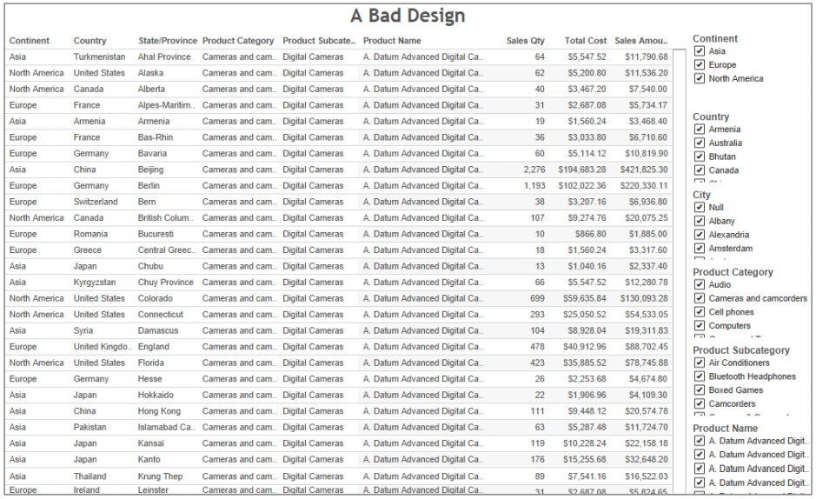
Guided Analytics with Dashboard Actions

Slide 110
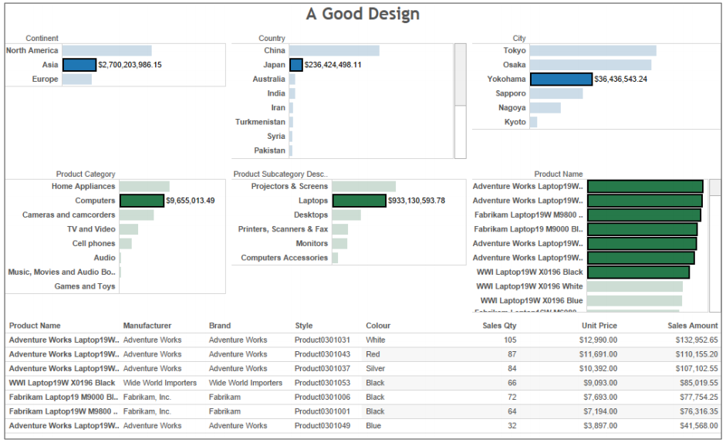
Guided Analytics with Dashboard Actions

Slide 111
Key differences between those designs
Bad Design | Good Design
No contextual guidance (Too much information) | User guidance (Natural: Left to Right, Top to Bottom)
Big query = Slow Performance (give me all records) System responsiveness will be affected due to poor design. | Highly aggregated query + Usage of charts as filters (dashboard actions) = Better Performance Response time is very fast, leading to a positive user experience.

Slide 112
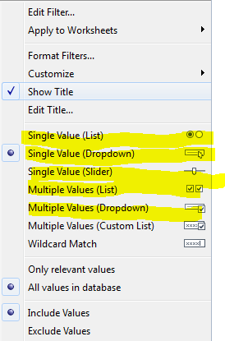
Filter: Enumerated
Enumerated quick filters require Tableau to query the data source for all potential field values before the quick filter object can be rendered.
These include:
Multiple value list
Single value list
Compact List
Slider
Measure filters
Ranged date filters

Slide 113
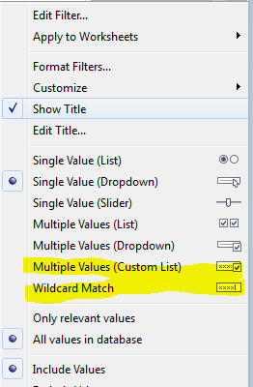
Filter: Non-Enumerated
Non-enumerated quick filters on the other hand, do not require knowledge of the potential field values.
These include:
Custom value list
Wildcard match
Relative date filters
Browse period date filters
Non-enumerated quick filters reduce the number of quick filter related queries that need to be executed by the data source.

Slide 114
Context Filters
By default, all filters that you set in Tableau are computed independently.
Each filter accesses all rows in your data source without regard to other filters
Context filters are implemented by writing the filter result set to a temporary table.
Any other filters are now dependent of the context filter. Only process the data stored in the temporary table
Context filters are used to improve performance.
However the process of creating the temporary table can be expensive on the database

Slide 115
Context Filters
Context filter is recommended when:
It reduces the size of the data set significantly – filtering 90% of the data
It is used against slow changing dimensions – if the filter is updated the database must re-compute and re-write the temporary table.

Slide 116
Filters: Best Practices
Avoid “Exclude” ̶ it prevents Tableau from leveraging indexes, forces a scan of all of the selected data
Avoid discrete filter use range filter whenever it is possible
Use relative date filter ̶ it is an easy way to show current week or month without republishing workbook
Avoid too many quick filters ̶ Use guided analytics using action filters

Slide 117
Calculations
Use Native Features
Grouping dimension members together – consider using groups or sets;
Grouping measure values together into ranged bands – consider using bins;
Truncating dates to a coarser granularity e.g. month or week – consider using custom date fields;
Creating a set of values that is the concatenation of two different dimensions – consider using combined fields;
Changing the displayed values for dimension members – consider using aliases.

Slide 118
Calculations
Follow those techniques to ensure your calculations are as efficient as possible
Date functions – Today() is better than NOW()
Use NOW() only if you need the time stamp level of detail otherwise use TODAY() for date level calculations.
Use Boolean whenever is possible
Slower:
IF [Date] = TODAY() THEN “Today” ELSE “Not Today” END
Faster:
[Date] = TODAY()

Slide 119
Calculations
Logic statements – ELSEIF better than ELSE IF
A nested IF computes a second IF statement rather than being computed as part of the first.
Slower:
IF [Region] = "East" and [Customer Segment] = "consumer"
THEN "East-Consumer"
ELSE
IF [Region] = "East" and [Customer Segment] <> "consumer"
THEN "East-All Others"
END
END
Faster:
IF [Region] = "East" and [Customer Segment] = "consumer"
THEN "East-Consumer"
ELSEIF [Region] = "East" and [Customer Segment] <> "consumer"
THEN "East-All Others"
END

Slide 120
Calculations
Avoid Redundant logic checks
Slower:
IF [Sales] < 10
THEN "Bad"
ELSEIF [Sales] >= 10 AND [Sales] < 30
THEN "OK"
ELSEIF [Sales] >= 30
THEN "Great"
END
Faster:
IF [Sales] < 10
THEN "Bad"
ELSEIF [Sales] >= 30
THEN "Great"
ELSE "OK"
END

Slide 121
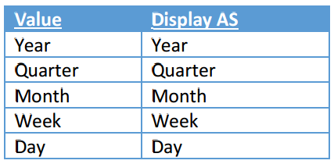
Calculations
Parameters for conditional calculations ̶ It helps the end user to change dynamically a calculation.
Slow:
IF [Parameters].[Date Part Picker] = "Year"
THEN DATEPART('year',[Order Date])
ELSEIF [Parameters].[Date Part Picker] = "Quarter"
THEN DATEPART('quarter',[Date])
…
ELSE NULL END

Slide 122
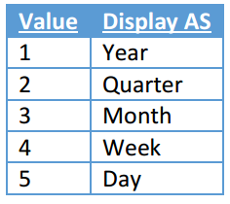
Calculations
Faster:
IF [Parameters].[Date Part Picker] = 1
THEN DATEPART('year',[Order Date])
ELSEIF [Parameters].[Date Part Picker] = 2
THEN DATEPART('quarter',[Date])
…
ELSE NULL END

Slide 123
Calculations
Fastest:
DATEPART([Parameters].[Date Part Picker],[Order Date])

Slide 124
Other Features of Data Extracts
Materialized Expressions
Access to Cloud Data Sources
Ability to publish to Tableau Public
Notes:
Other Features of Tableau Data Extracts
A few other advantages of TDEs are:
Materialized expressions. Tableau will “materialize” record-level calculations that use only fields from a single data source and are not dependent on run-time values — i.e. not using TODAY(), NOW(), USERNAME(), ISMEMBEROF(), or a parameter — as fully indexed & compressed fields in an extract. This can improve performance in many cases, for example when splitting name or address fields and/or creating datetime fields out of strings.
Access to cloud-based data sources. In order to make cloud-based sources such as Salesforce.com, Google Analytics, oData, and the Tableau Web Data Connectors useful for the kinds of at-the-speed-of-thought analytics that Tableau enables we have to use Tableau data extracts. Other cloud-based sources such as Amazon Redshift, Google BigQuery, and Microsoft Azure can be used as a live connection or extracted as needed.
Option to publish to Tableau Public. For performance reasons we can only use TDEs when publishing to Tableau Public.

Slide 126
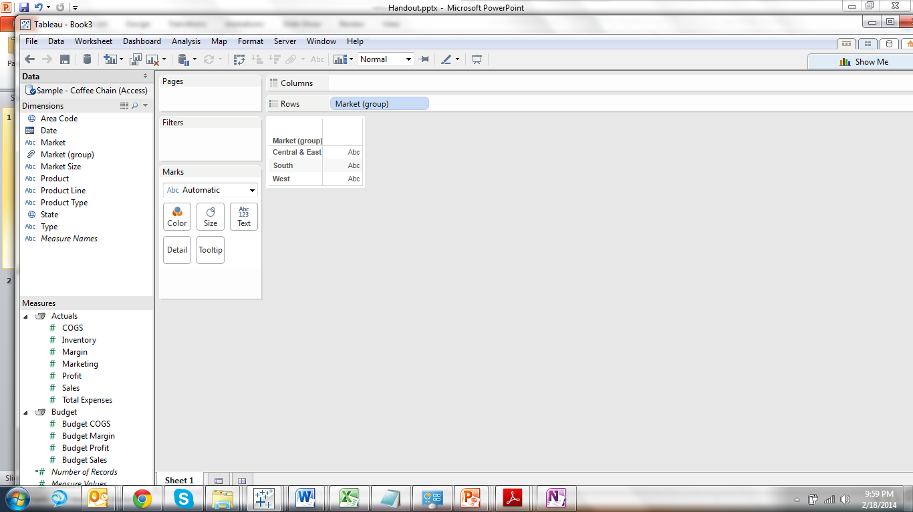
Dimensions vs. Measures
To switch a field from a dimension to a measure, simply drag and drop it into the correct window.
Dimensions
Dimensions are fields that contain qualitative or categorical information, which you might want to aggregate or splice your data by, for example, dates or strings.
Measures
Measures are fields that contain quantitative or numerical information, which typically produce an axes when added to the rows or columns shelves, for example, sums, averages, or counts.

Slide 127
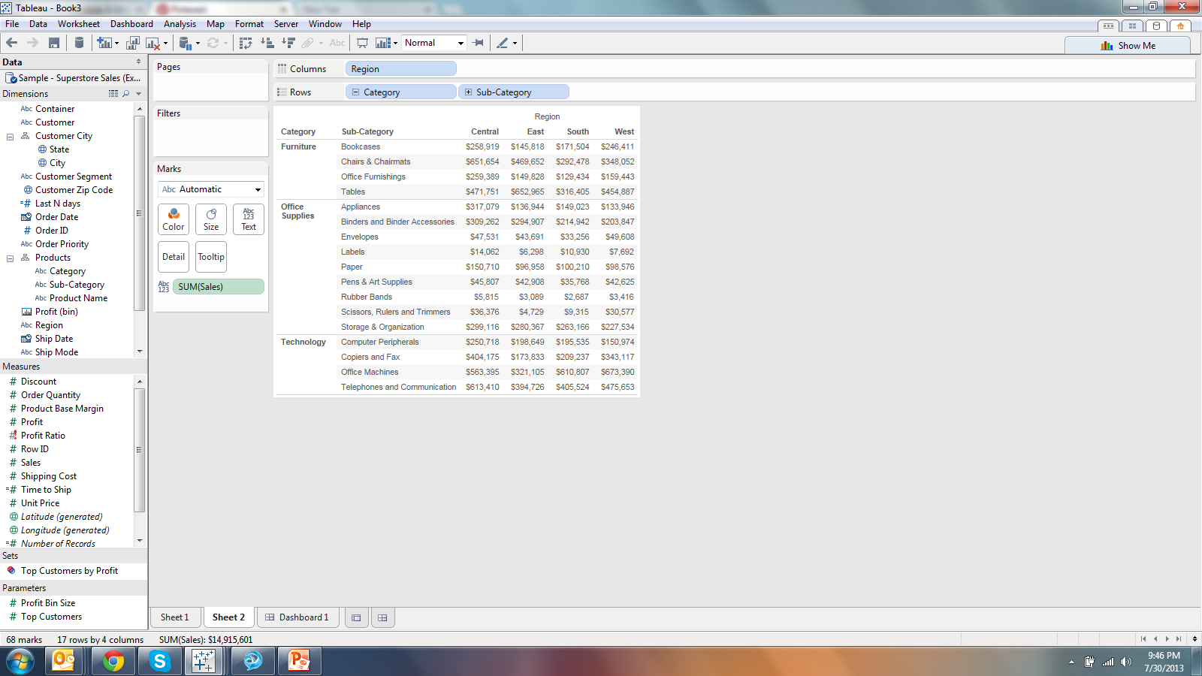
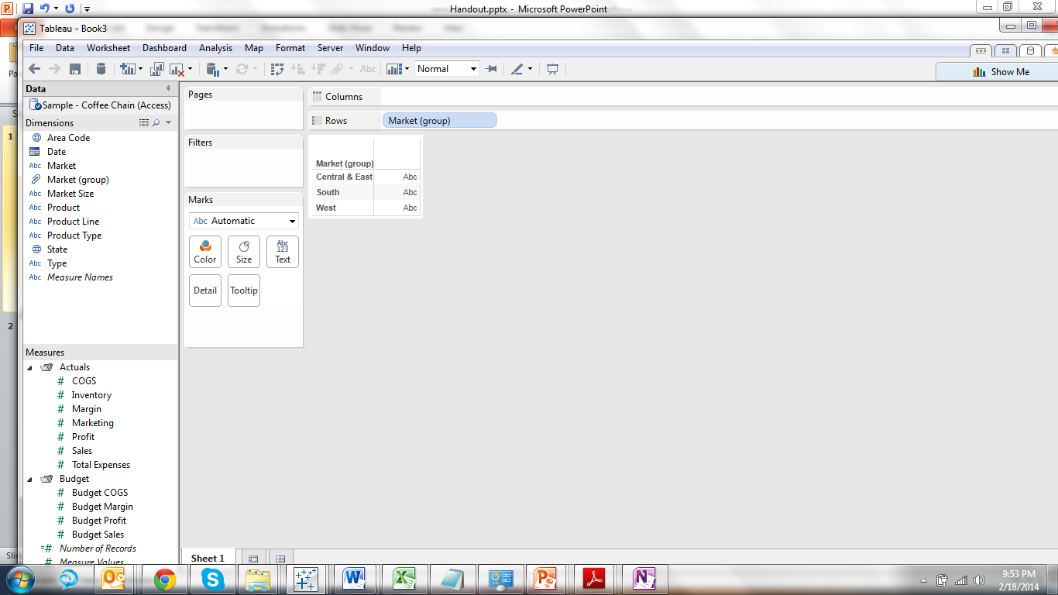
Data Icons
To find out more information about a field, including its domain or name in the data source, right click on the field and select Describe.
Blue icons indicate a field is discrete
Green icons indicate a field is continuous
Icons with an equal signs indicate the field is calculated
Icons with an exclamation mark indicate the field is invalid
String
Number
Date
Datetime
Geography
Bin
Hierarchy
Group

Slide 128
Calculations
To create a new calculation right click in the dimension or measures window and select “Create Calculated Field.”
Number | String | Logical
SUM() = Sum AVG() = Average TOTAL() = Sum of All Values in View COUNT() = Count of All Values COUNTD() = Count of Distinct Values | LEFT([Field], #) = Trims starting from the left. MID([Field], [Start Position], #) = Trims in the middle. STR() = Converts any field value to a string LEN() = Number of Characters in String SPACE(#) = Creates a blank | ZN() = If Null then Zero. ATTR() = Returns the value if all the rows have the same value, else returns *. CASE… WHEN… THEN… END IF… ELSEIF… ELSE… END

Slide 129
Working with Dates
Remember when dragging dates into the view to drag and drop with the right mouse button to bring up the Drop Date menu.
YEAR(Order Date)
MONTH(Order Date)
MY(Order Date)
November 2013
December 2013
January 2014
February 2014
2013 | November
 | December
2014 | January
 | February
MY(Order Date)
MY(Order Date)
November 2013
December 20103
January 2014
February 204
MY(Order Date)

Slide 130
Date Functions
Example Date Functions for 3/11/2014
DATENAME(‘month’, [Date]) | March
DATEPART(‘month’, [Date]) | 3
DATETRUNC(‘month’, [Date]) | 3/1/2014
DAY([Date]) | 11
Additional Date Functions
DATE() | Converts field or value in quotes to date type
DATETIME() | Converts field or value in quotes to datetime type
TODAY() | Date Stamp
NOW() | Date and Time stamp

Slide 131
What are the biggest challenges that you face with data… ex: access, quality, structure?
Discussion/Reflection
?
Notes:
Enrico Bertini of http://fellinlovewithdata.com/
This comment really hits a nerve on me as I have been thinking about this issue quite a lot lately. I must confess I am no longer satisfied with the word “visualization”. And I am even less satisfied by all the other paraphernalia people like to use: data visualization, interactive visualization, information visualization, visual analytics, infographics, etc.
The reason is that I think all these words do not describe well the work I and many other people do. While visualization seems to be appropriate when the main purpose is data presentation, I don’t think it captures the value of visualization when it is used as a data sensemaking tool.
When used for this purpose interaction is crucial. Analysis looks more like a continuous loop between these steps:
specify to the computer what you want to see and how (the specific visual representation)
detect patterns, interpret the results and generate questions
ask the computer to change the data and/or the visualization to accommodate the new question(s)
assess the results … repeat …
Analytical discourse is a term I saw used in the visual analytics agenda a few years back and I think it captures very well this concept. This all interplay and discourse between the machine and the human. This is what many of us are after and I am not sure the term visualization is able to express this concept in its entirety. The value of these tools is not exclusively in the visual representation; interaction plays a major role.
This became even more apparent to me while teaching my InfoVis course this semester. I teach a lot of things about visual representation but when students come down to building software for their projects, what they are really working on is a fully-fledged user interface. They have multiple linked views, search boxes, dynamic query sliders and all the rest. It’s interactive user interface design they end up doing, not visualization. And user interface design carries a lot of additional challenges that go beyond visual representation. Sure, designing the appropriate representation is still very important but many other choices impact the final results.
For instance all my students’ projects have multiple interactive views, maybe sometime just a main visualization, a list of terms and a couple of query sliders for dynamic filtering, but how do you call that? I call that visualization but in practice it’s a complex user interface. Or a “data interface” as suggested by Yin.
One last note. While thinking about this whole idea I recalled that Jeff Heer‘s lab at UW is calledInteractive Data Lab and I think he’s got it right. Interaction with the data is the main thing, visualization is the medium we use to create part of this interaction.

Slide 132
Today’s Lesson: How Data works in Large Orgs Getting Data to Tableau Once Data is in Tableau Hands On – Survey Data Homework

Slide 133
Today’s Lesson: How Data works in Large Orgs Getting Data to Tableau Once Data is in Tableau Hands On – Survey Data Homework

Slide 134
Build a concept board: http://www.dribbble.com http://www.flowingdata.com https://github.com/mbostock/d3/wiki/Gallery

